Slide 1
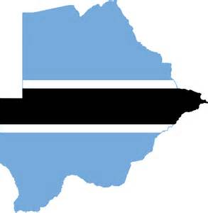
UNIDO ITPO, Italy
Presentation of Solar Industries Association Botswana
By Karen Giffard
www.sosolar.co.bw ● karen@sosolar.co.bw ● +267 74129413 ● Plot 42795 Magang Av, Phakalane, Gaborone, Botswana

Slide 2
Introduction of SIAB
CHAIRMAN
Felix Chavaphi
Energy Systems Group
TREASURER
Sofia Figuerua
ALTENOVA
EXECUTIVE MEMBER
Herman Ngwenya
Capricorn Solar
MEMBERS
Direct Motion Control
Chloride Botswana
Oriental Electrical
Solar International Botswana
Kebo Holdings
…………..
SECRETARY
Kate Mphaga
SolarOne
EXECUTIVE MEMBER
Karen Giffard
So Solar
Established in 2006 revitalised in 2015
Aim of the association is to facilitate wide scale use of solar in Botswana
Main Objectives:
Dissemination of information pertaining to the solar industry
Foster high standards of practice in design, installation, manufacture and maintenance
Cultivate highest ideals and ethics in industry
11 existing members including Executive Committee
Close working relationship with Department of Energy
Memorandum of Understanding with GIZ and German Solar Association

Slide 3
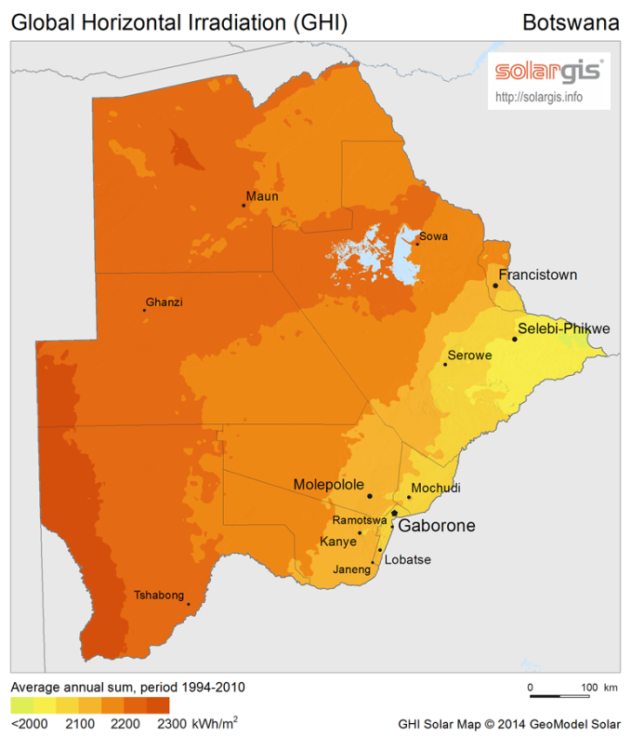
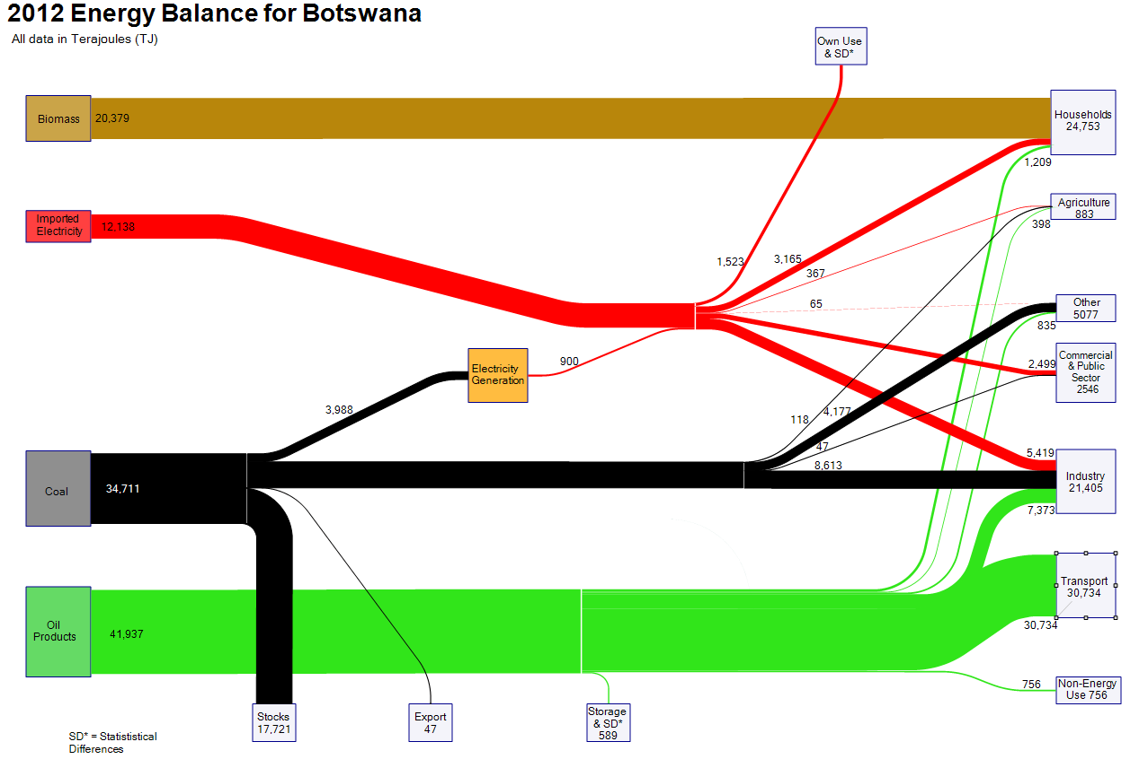
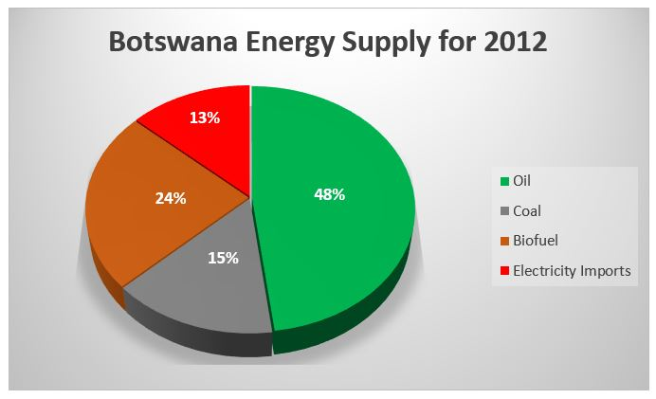
Botswana Overview
Solar estimated to make up less than 1% of energy mix with 75% made up of fossil fuels and 25% biomass/wood fuel. Electricity makes up approximately 26% total energy consumption.
3200 hours of sunshine and average of 320 clear sunny days per year.
GHI (Global Horizontal Irradiance), the country-wide average is 6.17 kWh/m²/day. (RE Strategy)
COUNTRY READINESS:
Target 15% emission reduction by 2030 driving focus on renewables
Recent EOI released for 100MW interest & 20 Hybrid Mini-grids
Evidence of willingness from previous project record & strategy development
Shift in focus to include green technology with ministry name change
Relatively good infrastructure
Reasonably high public familiarity with technology
Track record of stability and good governance
Areas still not connected to the grid with public facility electrification as a focus
Plans to increase electricity tariffs to become more cost reflective of generation
Private sector participation expected to rise
Image credit to countryreport.com

Slide 4
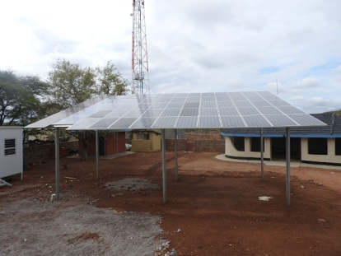
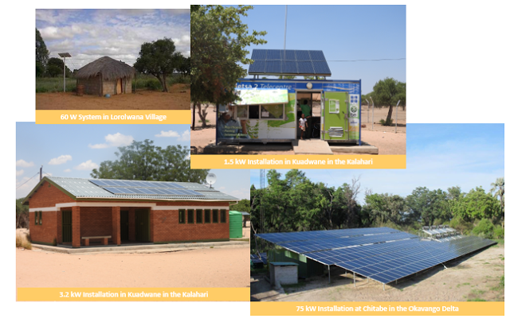
Photovoltaic Overview
PAST
BPC Lesedi : An arm off BPC focused on solar development to supply electricity services to rural areas. Project failed due to the innovative model being ahead of the technology.
PRESENT
1.3MW Phakalane Grid Connected System.
20KW Grid Connected Mokolodi Research Project
Off-grid lodges and farms (<5MW total)
21 Mini-grid schools (estimated 1MW total)
20 Hybrid (diesel/solar) Mini-grid out of potentially 96 rural villages
145 000 households Tier 1 small systems
Pumping water in remote farm areas
Eco lodges & residential
100MW EOI
FUTURE
Photo credit to Mike Mooiman Botswana Energy Blog

Slide 5
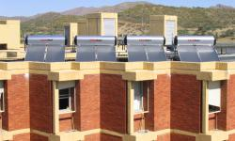
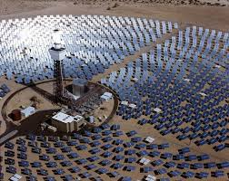
Thermal Overview
PAST
Government of Botswana installed solar water heaters on all public Institutions including schools, hospitals, police housing, government housing, military camps and universities.
PRESENT
Not quantified but quite significant.
Suggested 90% failure rate due to lack of standards, incorrected technology, lack of procurement framework and maintenance.
FUTURE
100MW EOI CSP
Roll out of residential solar water heaters, potentially incentive driven or with financial support
Agricultural solutions including green house technology
Building heating/cooling solutions

Slide 6
Potential Outcomes
Joint venture partnerships for EOI projects
Supply chain from manufacturers or distributors of Italian innovation
Capacity building or training opportunities
Consulting for framework development as per local market requirements
Quality performance and testing
Innovative turn-key solutions
Financial support to enable growth in local market, capacity or framework development
Local production potentially for regional market

Slide 7
THANK YOU

