Slide 1
Italmatch Chemicals
Advanced Water Solutions
UNIDO
27th March,2023
Richard Barwell
Sales & Marketing Director, MEA

Slide 2
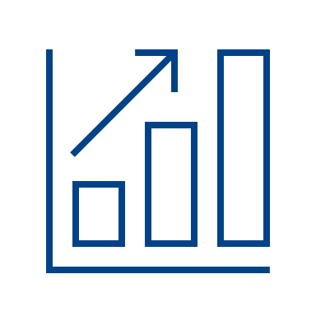
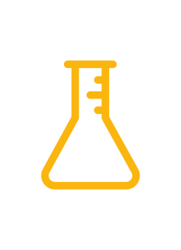
Italmatch at a Glance
For over 20 years,
sustainable chemistry
for a better life. Worldwide.
Our Group
Italmatch Chemicals is a leading global chemical group, specialising in performance additives and solutions for water treatment & lubricants, oil & gas and plastics, flame retardants and boasts a wide product range able to fulfil the requirements of the most demanding applications, including personal care.
6
Business Units
1100
Employees
€600m
Annual pro forma sales
19
Manufacturing sites
Our end markets
AWS numbers
6
R&D Centers
20%
Revenue from innovation pipeline
100
Patents granted
100
Research, development and technical support team
Performance Products
& Specialties
Advanced
Water Solutions
Flame
Retardants
Lubricant
Performance
Additives
Performance
Products
and Personal Care

Slide 3
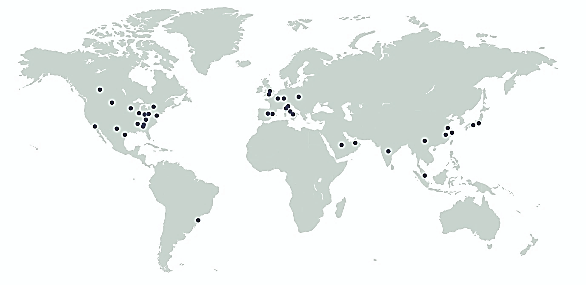
Italmatch Global Presence
Americas
EMEA
APAC
Brazil
Canada
USA
Belgium
France
Germany
Italy
Poland
Spain
UK
China
India
Japan
Saudi Arabia
Singapore
UAE
Flexible plants multi-chemistry IN DIFFERENT WORLD REGION OFFICES & LOGISTIC POINTS

Slide 4
Why partner with us?
We don’t just offer products,
we offer solutions
Fresh synergies
Dedicated
R&D and Technical Support teams
Innovative
Solutions
Sustainability Focus
Bespoke Solutions
Worldwide
Production
Facilities
Regionalisation Approach

Slide 5
Sustainability
We have a
sustainable business model
Our technology helps to manage water resources
We have a global vision with a local presence bringing shared values and wellness to our stakeholders
We are passionately committed to helping
our customers meet today’s (and tomorrow’s)
increasingly demanding sustainability
targets and regulatory requirements,
especially by conserving water, minimising waste
and promoting energy efficiency
Respect for people, the environment and
local communities
We are constantly adapting and researching

Slide 6
Our end markets
Our specialty water management additives are used throughout the world across industries including:
Fabric &
Home Care
Industrial
&
Institutional
Industrial Water Treatment & Process
Membrane Desalination
Thermal Desalination
Geothermal
Mining
Personal
Care

Slide 7
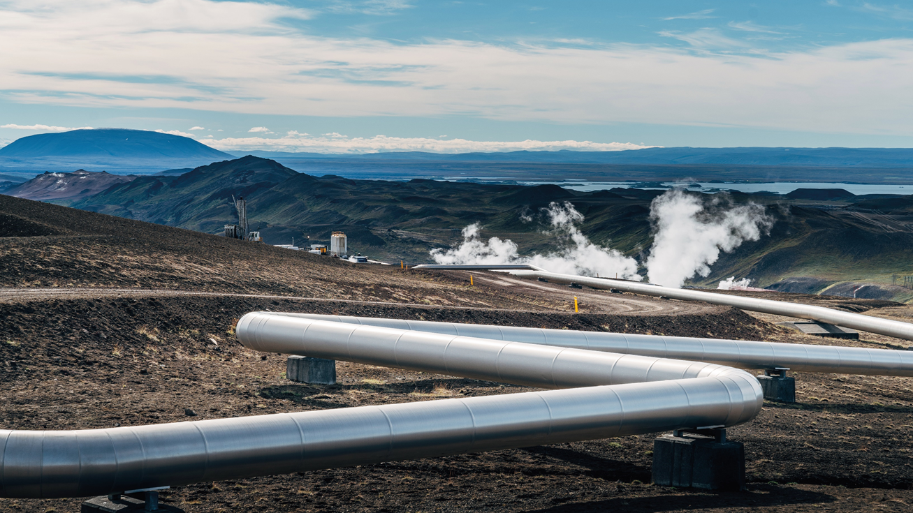
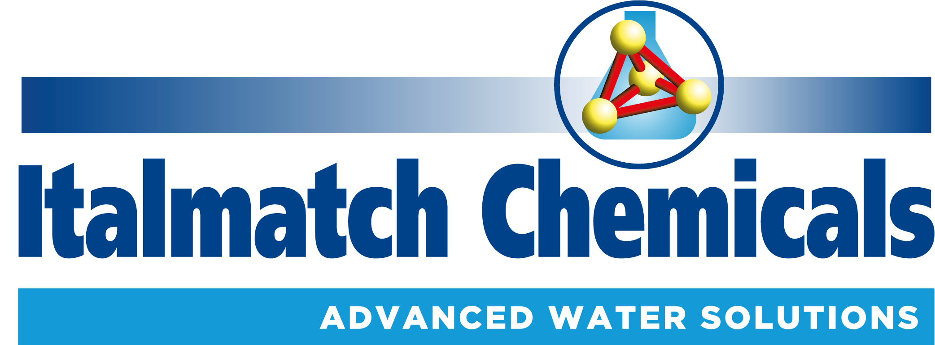
7.7 M€/yr = Annual Revenues
15% = Target Vitality Index
8 Products Portfolio (4 new)
Direct Sales/Technical Support Approach
Geothermal
Functionalities
Antiscalants, Corrosion inhibitors
Applications
Calcite scale, Amorphous silica scale, Metal silicate scale
Antimony Trisulfide (Stibnite) scale, Naturally Occurring Radioactive Material (NORMS)
Innovative, thermally stable, dispersants and inhibitors to maximise system efficiency and extend plant lifetime

Slide 8
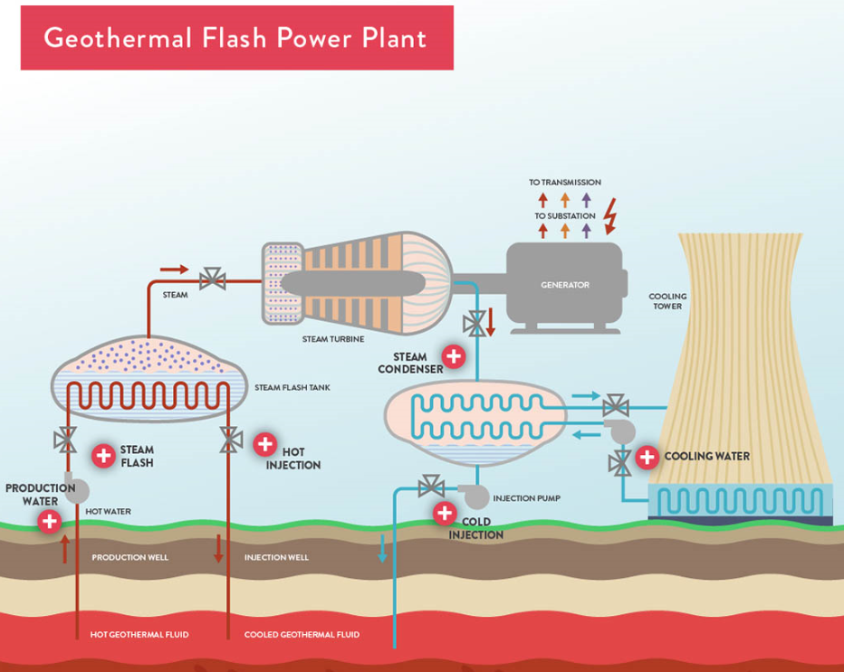
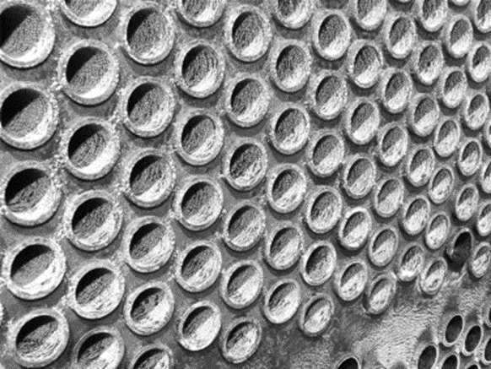
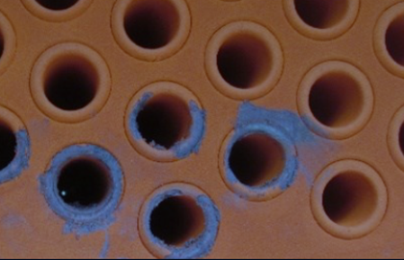
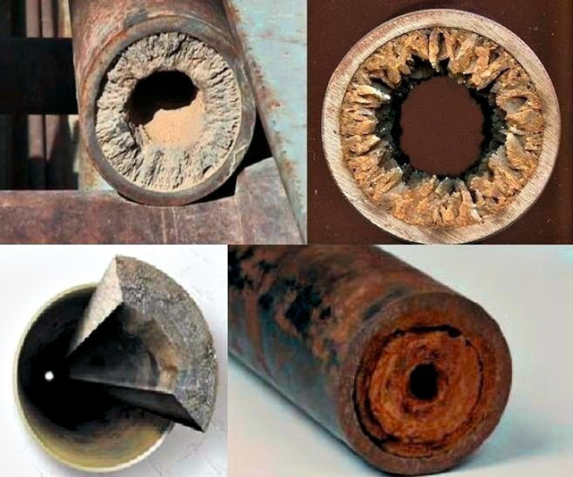
Typical Scale Challenges
SURFACE EQUIPMENT
Calcite
Metal Sulfide
Silica
Stibnite
Corrosion
COOLING WATER
Scale
Corrosion
Biological Growth
HOT & COLD REINJECTION
Calcite
Metal Sulfides
Lead
Copper
Silica
Stibnite
PRODUCTION WELL
Calcite
Sulphate (Ca, Sr, Ba)
Metal Sulfides
Silica
Amorphous silica
Metal silicates
Stibnite
Crystalline Sb2S3 grey black
Metastibnite Sb2S3 red

Slide 9
Product Portfolio
New product developments
Geogard® HCA
Calcium Carbonate
Scale Control
Geogard® SX2
Silica
Scale Control
Geogard® SX3
Silica
Scale Control
Geogard® N
NORMS
Scale control
Geogard® CA/ACA
Calcium Carbonate
Scale Control
Geogard® SX
Amorphous Silica
Scale Control
Geogard® SB
Stibnite
Dispersant
Formulation to provide excellent CaCO₃ scale inhibition under severe conditions up to 250 -300°C
High thermal stability
Typical Dosage 3-20ppm
Formulation to provide extended levels of dispersive control where Silica levels are >400ppm
Effective at high temperature
Typical Dosage 5-20ppm
Formulation to better inhibit the formation of amorphous Silica and in the presence of highly charged cations (Al³⁺, Fe³⁺)
Stable at high temperature
Typical Dosage 5-20ppm
Formulation to inhibit the precipitation of NORM’s materials such as Radium-226 and Radium-228 which can be trapped in spaces within the sulfate salt crystals
High performance product designed for Calcite scaling control
Consistent performance at high temperature (up to 150°C)
Unaffected by Oxidizers
Increase productivity and reduce mechanical cleanout & well work over
Typical Dosage 5-20ppm
High performance product designed for Silica scaling control
Consistent performance at temp higher than 250°C
Effective treatment at SSI greater than 2.5
Increase productivity and reduce mechanical cleanout & well work over
Typical Dosage 10-20ppm
High performance dispersant
Consistent performance at temp higher than 200°C
Capable of keeping metal salts in solution
Minimise deposition and corrosion
Typical Dosage 10-20ppm
Geogard® CI | Under development | Corrosion Inhibitor for Geothermal applications.

