Slide 1
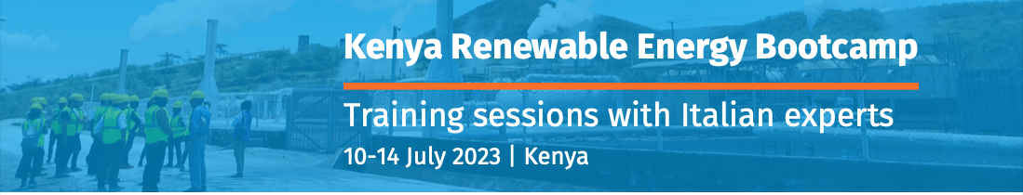
Recommendations for environmental safety: a case study from Europe
Social aspects and public engagement of geothermal communities
Adele Manzella
CNR-IGG, Pisa, Italy
manzella@igg.cnr.it

Slide 2
Geothermal energy at CNR in 1 slide
Optimisation and development of advanced technologies for subsurface exploration, resource assessment, and sustainable production from geothermal systems
Research and Development
Assisting in the development of guidelines for the utilisation of geothermal energy
Geothermal energy for society
Promotion of best practices: market strategies, economic and environmental aspects
Technological Solutions
Policy and Society
Disseminating the potential of geothermal energy
Contribution to professional qualification

Slide 3
Research topics in geothermal energy at CNR
Assessment: location, geometries, and vulnerability of deep geothermal resources, energy content
Exploration: new or improved technologies, data integration, and better imaging of the subsurface
Understanding geological processes, including by modelling properties (e.g. hydraulic, physical, geotechnical and geomechanical). Prediction of natural or induced trends in the extraction of fluids and heat from the subsurface, re-injection of fluids
Environmental aspects: monitoring and mitigation, analysis of the quality of environmental matrices, study and control of emissions
Optimisation of climatization technologies with geothermal heat pumps, and integration in various geological and cultural contexts (e.g. historic buildings)
Geothermal thesaurus (terms, glossary).
Studies on the social acceptability of geothermal energy in areas of varying criticality

Slide 4
A global and general issue
We are not an exception
“Sustainable energy solutions, including renewable energy, have sometimes suffered from the perception that they come with too many trade-offs, at the expense of overall socio-economic development.
Undoubtedly, as governments around the world strive to put the 2015 Paris climate agreement into practice, they need to balance the urgency of the energy transition against numerous other considerations that affect people’s welfare.”
from Renewable energy benefits: understanding the socio-economics, International Renewable Energy Agency (IRENA)

Slide 5
A change of perspective
profitability
Triangle of energy generation
DECISION
supply
security
environmental compatibility

Slide 6
A change of perspective
profitability
environmental compatibility
social acceptance
Triangle of energy generation
Square of energy generation
DECISION
supply
security
environmental compatibility
supply
security
profitability
Square/ Triangle of energy generation (modified from Hauff, et al. 2011)
Notes:
I primi tre sono sotto il controllo dall’operatore, mentre gli aspetti sociali sfuggono al controllo. E.G. information asymmetries (riservatezza per competizione recepita come poca trasparenza)

Slide 7

A difference in perspective
economic benefits
socially responsible: by fighting global-scale issues – e.g. through GHG emission reduction and climate change mitigation
direct economic benefit
avoid (perceived) negative impacts at the local scale
territories and citizens
policy makers energy companies
Decisions concerning the use of energy resources are made at many levels: individual, community, national, and international

Slide 8
Governance vs regulation
An attempt to shelter the institutional crisis (of legitimacy, credibility and above all trust of citizens) was the introduction of the concept of
governance (a negotiation process that guarantees a form of social regulation)
as an alternative to
top-down political regulation (i.e. to the hierarchical control of central institutions),
the strictly intended market regulation (based on the principle of utility exchange)
community regulation (based on the principle of reciprocity).

Slide 9
Public participation in EU
EU legislation establishes a legal obligation of public participation before a deep geothermal project is granted a development consent: the public must be given the opportunity to be informed and express its opinion.
This legal inquiry is flexible, and the Member States determine how they wish to inform the public.

Slide 10
Why engaging the public with geothermal energy
Increase trust among scientist, policy makers and citizens
Increase public scientific literacy
Concrete inputs for scientists, innovators and policy makers
Funding new business opportunities
Improve the innovation policies thanks to a better understanding of public and stakeholders views
Inclusion of public needs in the innovation process, aligning innovation to societal needs
Consumers are becoming prosumers

Slide 11
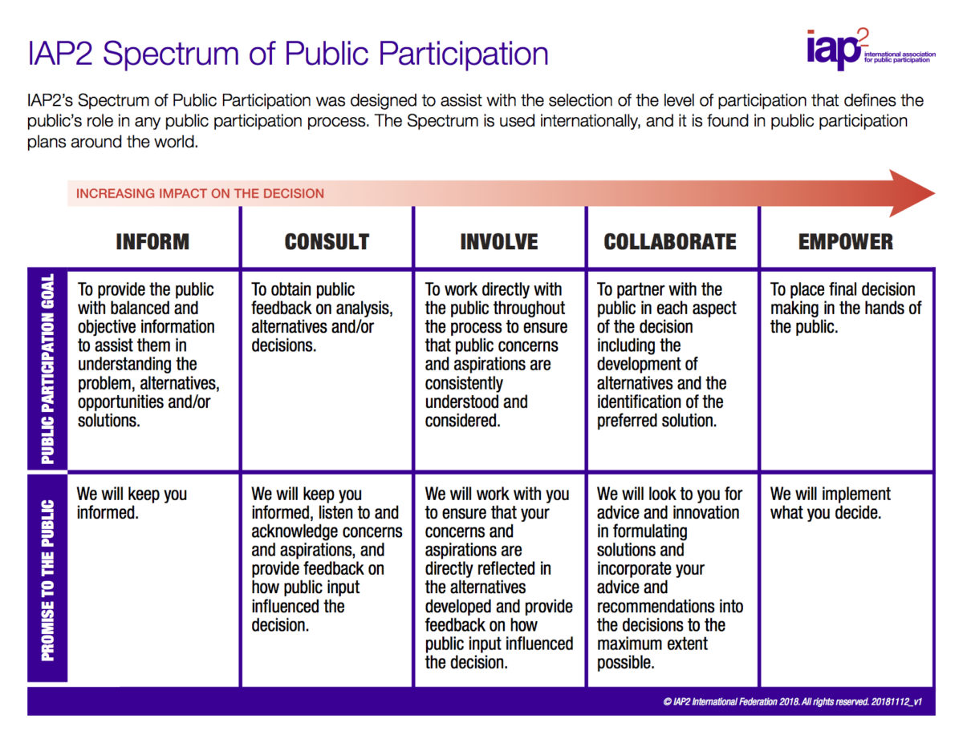
Levels of participation
Communication:
One way
Two ways
Deliberative
All of them valuable
Aware that are differences and clear objectives

Slide 12

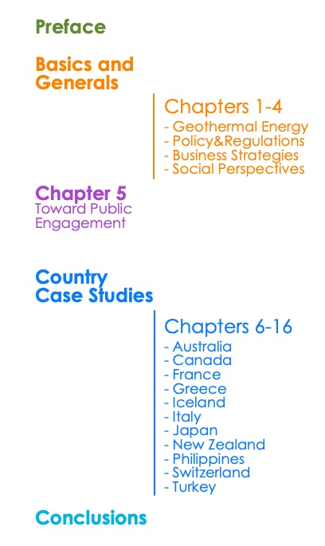
A global comparison of national experiences
A book to collect information and compare experiences:
What drives the harnessing of geothermal resources?
Different perception of heating&cooling and electricity production technologies
Ownership and management of geothermal resources
Attitude toward geothermal energy technologies
Forms of societal engagement

Slide 13
A global comparison of national experiences
Sources of perplexities
The key role of communication
Are perplexities about geothermal technologies or about geothermal governance?
Hard energy path/soft energy path raise different issue
Lack of information
Environmental concerns
Unfortunate experiences
How would energy be used? (what is the final goal?)
Sparse, incomplete information
Geothermal energy is less familiar than other energy sources
Geothermal energy is shrouded in uncertainty
Trust in scientists and researchers as source of information
Curricula in science communication
Professionals and economic resources within industrial and research organizations

Slide 14
Preliminary conclusions
We need:
To consolidate forms of dialogue, to facilitate taking into account the views of local communities and the general public.
Quantitative and semi-quantitative data on social aspects, otherwise we are lost in the perception realm. But also a common measuring approach, enabling data comparison, also among different sectors.
To bridge competences and roles.
Common “places” (e.g. platforms as ETIP-DG, citizen’ forums, open research centres).
It is necessary to optimize regulation to embed these aspect in an efficient way.
It does not regard only social acceptance, it is about co-creating the future together with citizens and society as a whole

Slide 15
Observation and background: a European perspective
The advantages of using geothermal for power production and H&C are not widely known. Recently, deep geothermal energy production in some regions is confronted with a negative perception, and a special attention from some decision-makers, in terms of environmental performance, which could seriously hamper its market uptake.
Media reports focus more on disadvantages than advantages. As a result, decision makers and potential investors have concerns about possible environmental impacts and risks involved in implementing geothermal projects, and social resistance often results in practical obstacles - such as significant slowdowns - to the deployment of the deep geothermal resources.

Slide 16
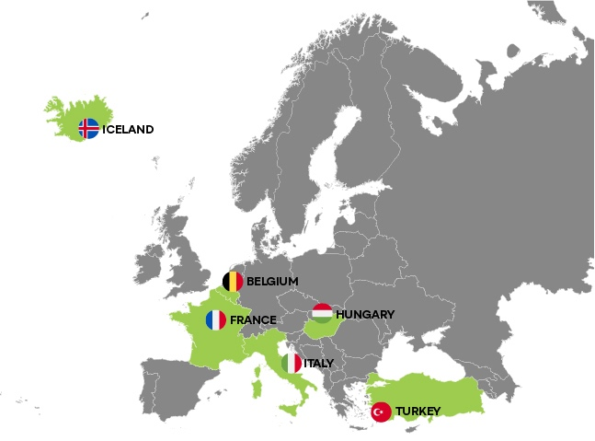

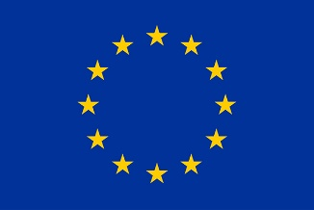
A European project for
Tackling environmental concerns to deploy geothermal energy in Europe
European Union’s Horizon 2020 G.A. 818242
https://www.geoenvi.eu
GEOENVI targeted six countries :
Iceland, France, Belgium, Italy, Hungary and Turkey

Slide 17
Key actors
Public environmental institutions and regulatory authorities > implement and/or make the environmental regulations: they will exchange on best practices, tend to adopt the GEOENVI recommendations and methodologies, and envisage the harmonization / mutual recognition with minimum standards, of their environmental regulations
Industry & project developers > develop geothermal projects: they will be consulted on environmental impact and LCA, and be asked to implement methodologies and tools. GEOENVI aims especially at representing a variety of power and DH project developers in Europe. These geothermal project developers and operators (more than 70 companies) are represented directly and indirectly by geothermal associations in GEOENVI
Scientific experts > guarantee sustainability: they will support drafting of environmental regulations for the legislators and design methodologies and tools on environmental impact and LCA for industry.

Slide 18
Adopted solutions to overcome environmental concerns related to geothermal deployment
A MAIN GOAL OF ENERGY GENERATION TECHNOLOGIES IS TO HAVE ONLY POSITIVE IMPACTS AND NO RISK
1st rule: prevention. it is possible to avoid problems, in most cases, by considering potential negative effects at an early stage of design and avoiding them by using preventive alternatives and tools
This is not always possible, therefore
2nd rule: mitigate any possible risks and negative impacts (environmental, economic) while maximising positive impacts (in addition to electricity and heat production, increased tourism by-products or other non-direct financial and social benefits)

Slide 19
Mitigation measures
SYSTEMS TO REDUCE, AVOID OR COMPENSATE FOR POTENTIAL NEGATIVE ENVIRONMENTAL CONSEQUENCES OF INDUSTRIAL PROJECT DEVELOPMENT ACTIVITIES
Mitigation is a regulatory procedure embedded in all international interpretations of environmental impact assessment (EIA). It comprises three forms of measures *:
Prevention, which means that the potential impact is prevented or reduced before it occurs.
Corrective measures, reducing the impact to an acceptable level **.
If preventive or corrective measures fail, then compensatory measures apply. They will compensate for the unavoidable impact
* European Environmental Impact Assessment Directive
** See legislation

Slide 20
A report on environmental concerns
Effects associated to surface operations
Energy and water consumption and emissions to the environment
Effects associated to emission of underground material to the surface
Liquid/solid effusions and waste
Effects associated to geomechanical changes
Ground surface deformation
Effects associated to underground physical and chemical modifications
Waste production from surface operations
Surface disturbance, including vibration, noise, …
Leaks due to surface installations and operations
Degassing
Radioactivity
Blowout
Seismicity
Pressure and flow change
Interconnection of aquifers and disturbance of non-targeted aquifers
Thermal changes
Adopted solutions to overcome environmental concerns related to geothermal deployment
1° step: define the problem
Events that needs control and mitigation have been ranked and analysed. categorization of effects based on safeguard subjects, i.e., endpoint indicators
The described scenario is a worst-case one, where all potential problems occur at the highest grade.
In reality this is far from representing a real case, as some impacts and risks are accidental or restricted to very defined geological condition or technologies.

Slide 21
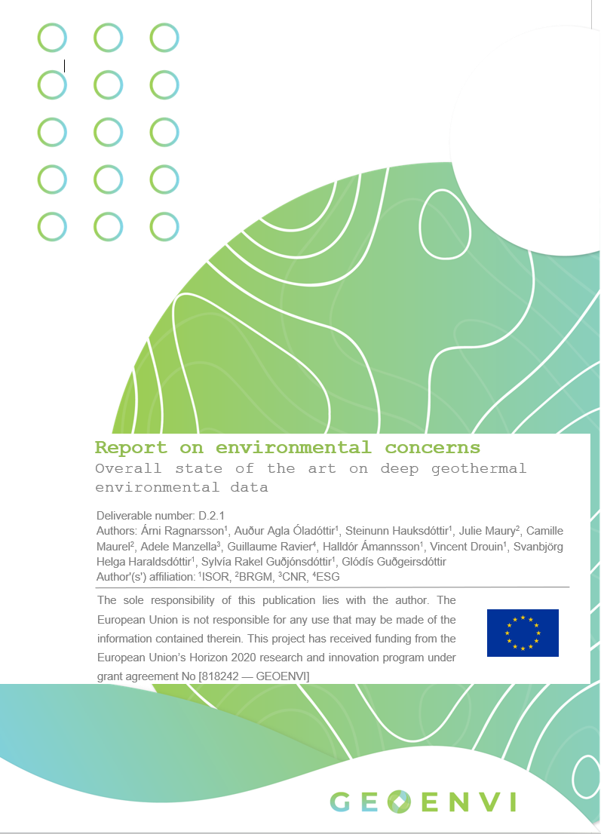
Full report
In the introduction, the perimeter of the study, as well as the public targeted for this report, is clearly explained. Then, for each topic, a synopsis is provided along with the summary.
Subchapters
Origin
Project phases
Influencing contexts
Risk or impact
Consequences
Monitoring
Prevention and mitigation
Illustrative examples
FULL REPORT:
https://www.geoenvi.eu/publications/report-on-environmental-concerns-overall-state-of-the-art-on-deep-geothermal-environmental-data/

Slide 22
A focus on Mitigation measures
Effects associated to surface operations
Energy and water consumption and emissions to the environment
Effects associated to emission of underground material to the surface
Liquid/solid effusions and waste
Effects associated to geomechanical changes
Ground surface deformation
Effects associated to underground physical and chemical modifications
Waste production from surface operations
Surface disturbance, including vibration, noise, …
Leaks due to surface installations and operations
Degassing
Radioactivity
Blowout
Seismicity
Pressure and flow change
Interconnection of aquifers and disturbance of non-targeted aquifers
Thermal changes
Adopted solutions to overcome environmental concerns related to geothermal deployment
2° step: control intensity of produced effect, if any
Monitoring environmental quality before, during and after deployment

Slide 23
A focus on Mitigation measures
Effects associated to surface operations
Energy and water consumption and emissions to the environment
Effects associated to emission of underground material to the surface
Liquid/solid effusions and waste
Effects associated to geomechanical changes
Ground surface deformation
Effects associated to underground physical and chemical modifications
Waste production from surface operations
Surface disturbance, including vibration, noise, …
Leaks due to surface installations and operations
Degassing
Radioactivity
Blowout
Seismicity
Pressure and flow change
Interconnection of aquifers and disturbance of non-targeted aquifers
Thermal changes
Adopted solutions to overcome environmental concerns related to geothermal deployment
3° step: reduce, avoid, or offset the potential adverse environmental consequences of development activities, by means of mitigation measures.
Mitigation measures can be in the form of preventive, corrective, or compensatory measures. Prevention means that the potential impact is prevented or reduced before it occurs. Corrective measures reduce the impact to a level that is acceptable. If preventive or corrective measures fail, then compensatory measures are applied.
We described preventive and corrective measures.

Slide 24
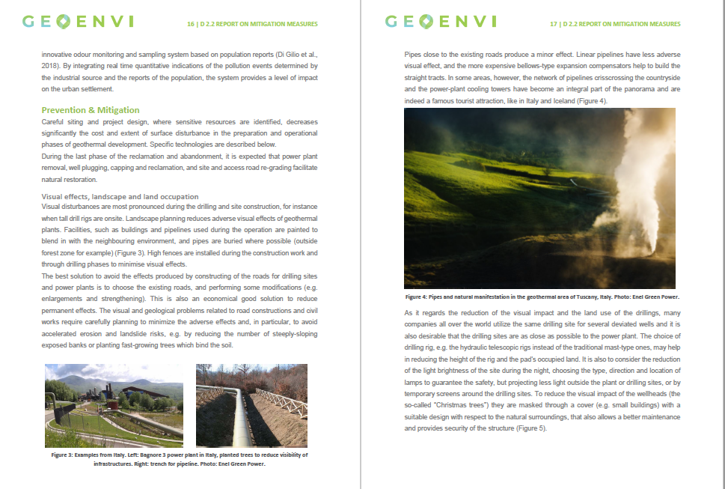
Examples
SURFACE DISTURBANCE: LAND OCCUPATION, VISUAL, NOISE, VIBRATION, DUST, SMELL
MONITORING:
seismic sensors for vibration, acoustic characterization before and during operations, biodiversity monit., smell assessment and limitations
MITIGATION:
Landscape planning, pipes’ layout, choice of drilling rig to reduce the height of the rig and the pad’s occupied land, cover for well-head.
Planning for optimal noise reduction: muffled materials and insulation, activities’ timing; information to population for unavoidable temporary emissions.
Prevention of dust dispersion by cleaning, water spray, use of water channels for transport.
…

Slide 25
Description
Information sheets (wiki sheets) were prepared for each of the 12 topics selected, most of them 7-12 pages.
The sheets are all structured in the same way with standardized subchapters to harmonize the presentation of the different topics.

Slide 26
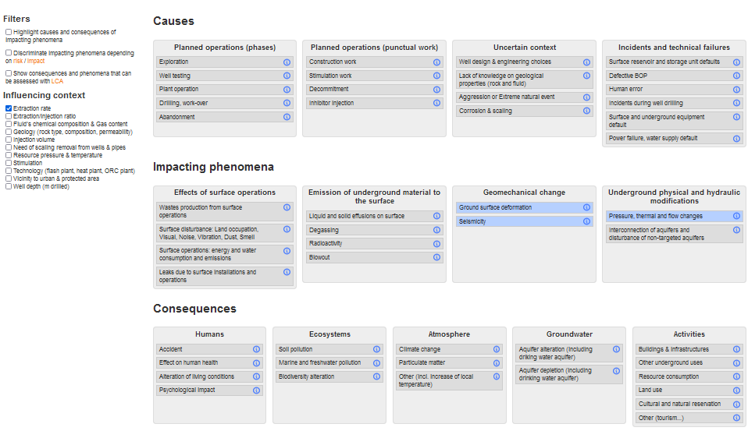
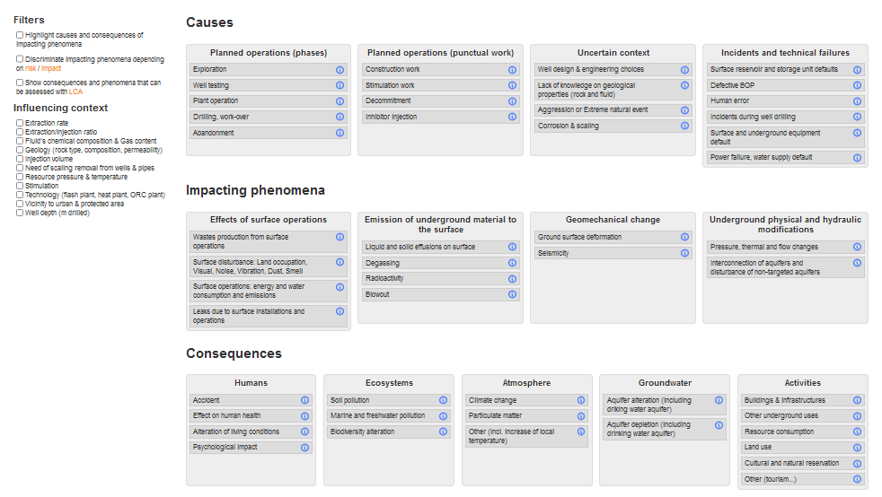
An online tool for exploring environmental aspects
https://geoenvi.brgm.fr/en
https://geoenvi.brgm.fr/en/environmental_aspects
Subchapters
Origin
Project phases
Influencing contexts
Risk or impact
Consequences
Monitoring
Prevention and mitigation
Illustrative examples

Slide 27
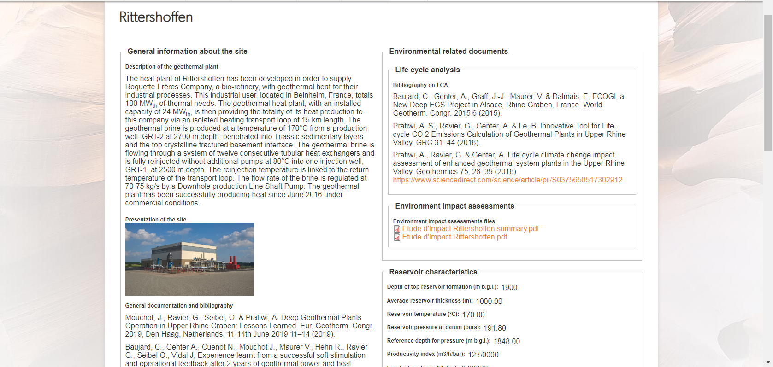
Site database
https://geoenvi.brgm.fr/en/operations
Environmental information on sites

Slide 28
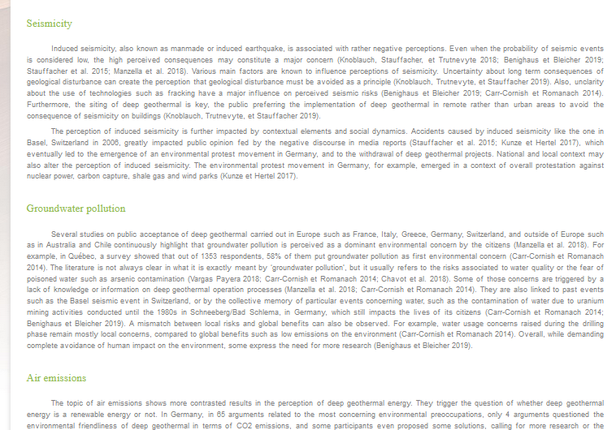
Perception (D2.3)
https://geoenvi.brgm.fr/en/page/perception

Slide 29
GEOENVI to analyse environmental effects from geothermal development
Impacts, risks and mitigation measures
categorization of effects based on safeguard subjects, i.e., endpoint indicators
available mitigation measures (on a worst case scenario) and current best practise
Conclusions
Monitoring is common practice, and data are checked against established limit values
All the environmental effects analysed are well documented and mitigation measures have proven to be effective, and with current technology, it is possible to keep geothermal industrial development safe and sound (see LCA analyses as the main result of the project).
Research and Innovation are proceeding and innovative solutions are continuously improving the environmental friendliness of geothermal technologies.
All phases of a geothermal project can potentially have an environmental implication. Mitigation (preventive, corrective and compensatory) is an integral regulatory procedure in all international interpretations of environmental impact assessment (EIA), as required by law.
Worst case scenario (all negative potential impacts and risks) and preventive, corrective tools
Impacts/risks Mitigation Regulation

Slide 30
GEOENVI to analyse environmental effects from geothermal development
Recommendations for improved regulatory practice
Mapping environmental regulations applied to geothermal in GEOENVI case study countries (Belgium, France, Hungary, Iceland, Italy, Turkey)
Listing impacts, risks and mitigation tools
Policy and regulations
  Further questions:
  What are remaining regulatory gaps or challenges?
  Further details on thresholds, technical prescriptions, and mitigation measures
  How are legislations applied in practice? Which informal aspects come into play?
  What elements of national regulations and guidelines can be shared among countries?
Overview
  General data on deep geothermal
  Institutional context
  Policies and policy visions
Regulation mapping
  Definition, classification, and resource ownership
  Licensing and authorizations
  11 specific environmental impacts and risks: International, EU and national level
Environmental impacts and risks appear generally well covered by:
Specific legislations and guidelines
Covered in Environmental Impacts Assessments and permitting processes
Good practice among project developers and operators
Technical topics Aeriform emissions Aquifers’ interference Discharge of geothermal fluids Seismicity | Process topics Complex licensing and delays Dealing with uncertainty EIA Local benefits Public participation Sharing information
Notes:
I will mention that the choice of topics have been defined by partners, as result of the analysis, and with stakeholders’ and decision-makers engagement in the form of workshops, interviews, partners’ national engagements

Slide 31
Policy briefs and factsheets
https://www.geoenvi.eu/publications/geoenvi-recommendations-on-environmental-regulations-for-geothermal-energy/
Streamlining administrative and assessment procedures for geothermal projects
  Complex licensing and delays & Environmental Impact Assessment (EIA)
Air quality and geothermal projects
  Aeriform emissions
Harmonising the management of potential risks from seismicity in deep geothermal projects
  Seismicity
Protecting water reservoirs during the design and construction of geothermal projects
  Aquifers’ interferences and physical disturbances & Discharge of geothermal fluids
Fostering constructive interactions with the public during geothermal projects
  Information sharing, Local Benefits & Public participation
Using Life Cycle Analysis for sustainable finance

Slide 32
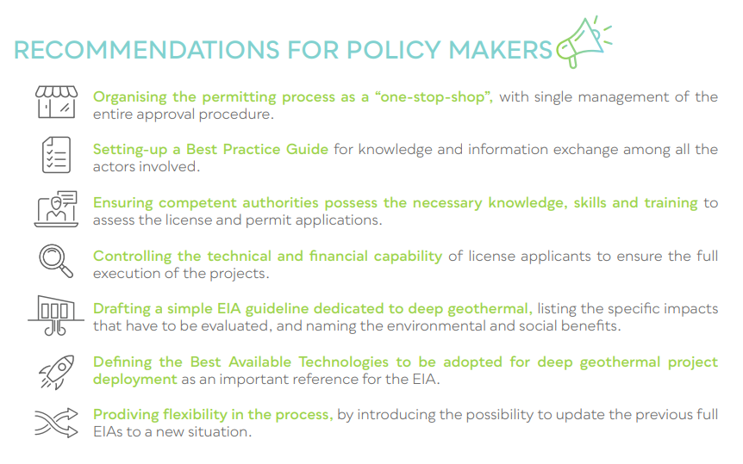
https://www.geoenvi.eu/wp-content/uploads/2021/05/EGEC_Factsheet-Administrative-procedures-Final.pdf

Slide 33
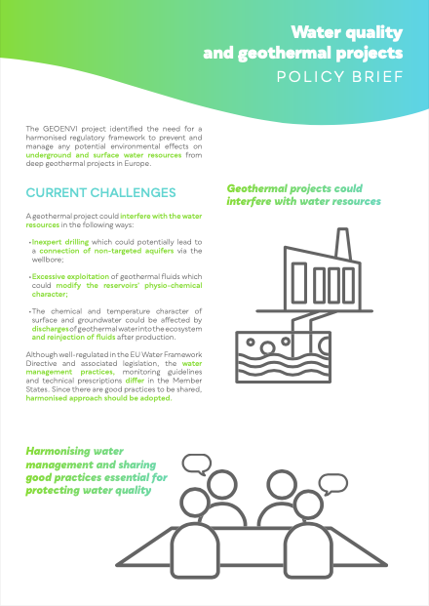
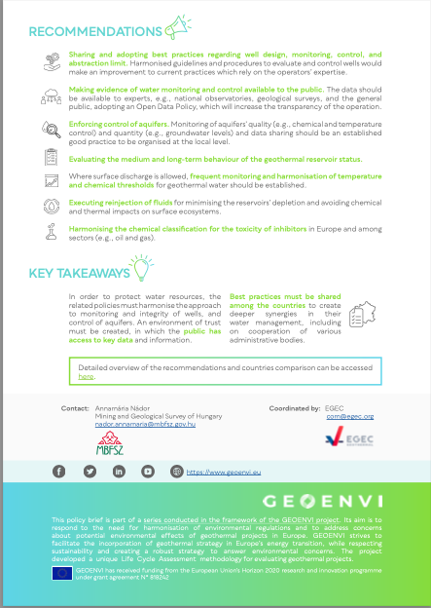

Slide 34
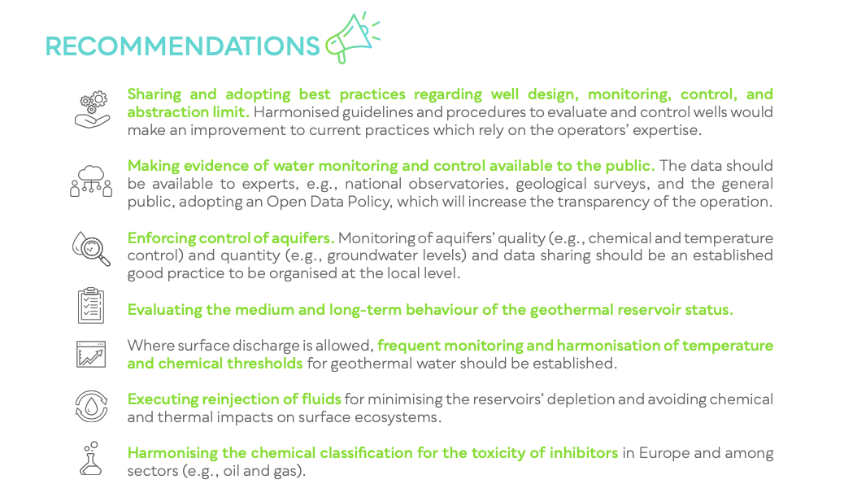

Slide 35
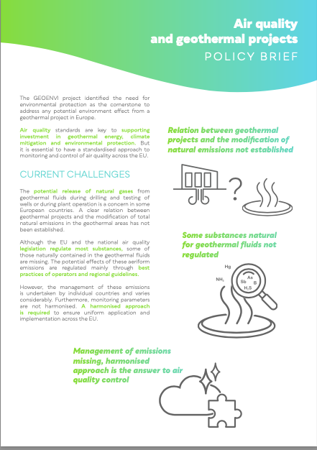
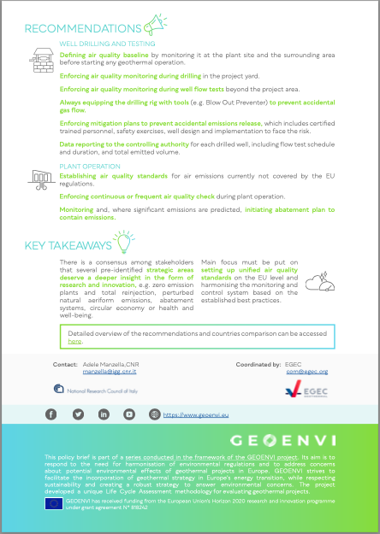

Slide 36
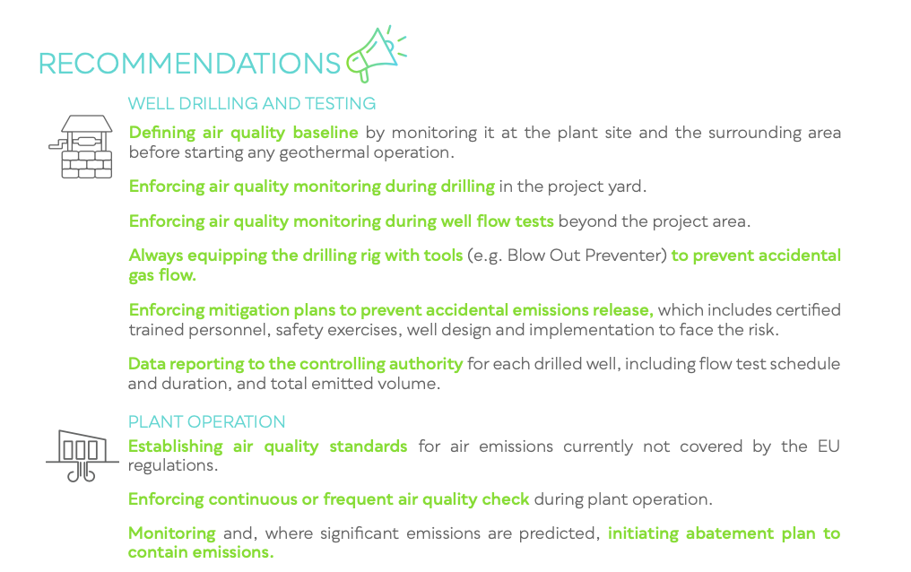

Slide 37
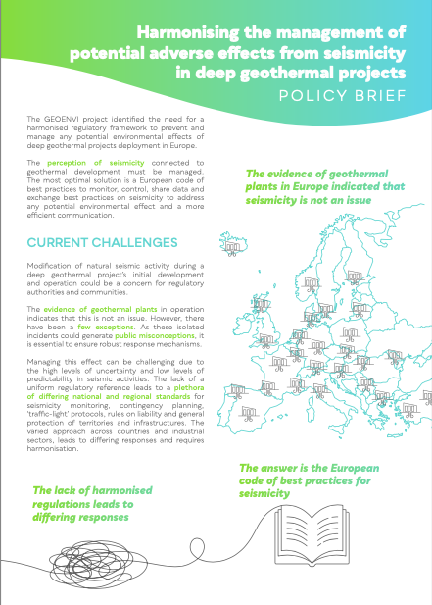
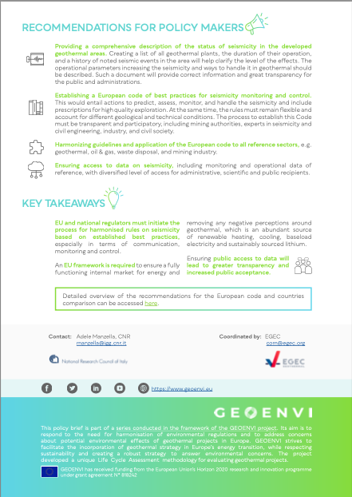

Slide 38
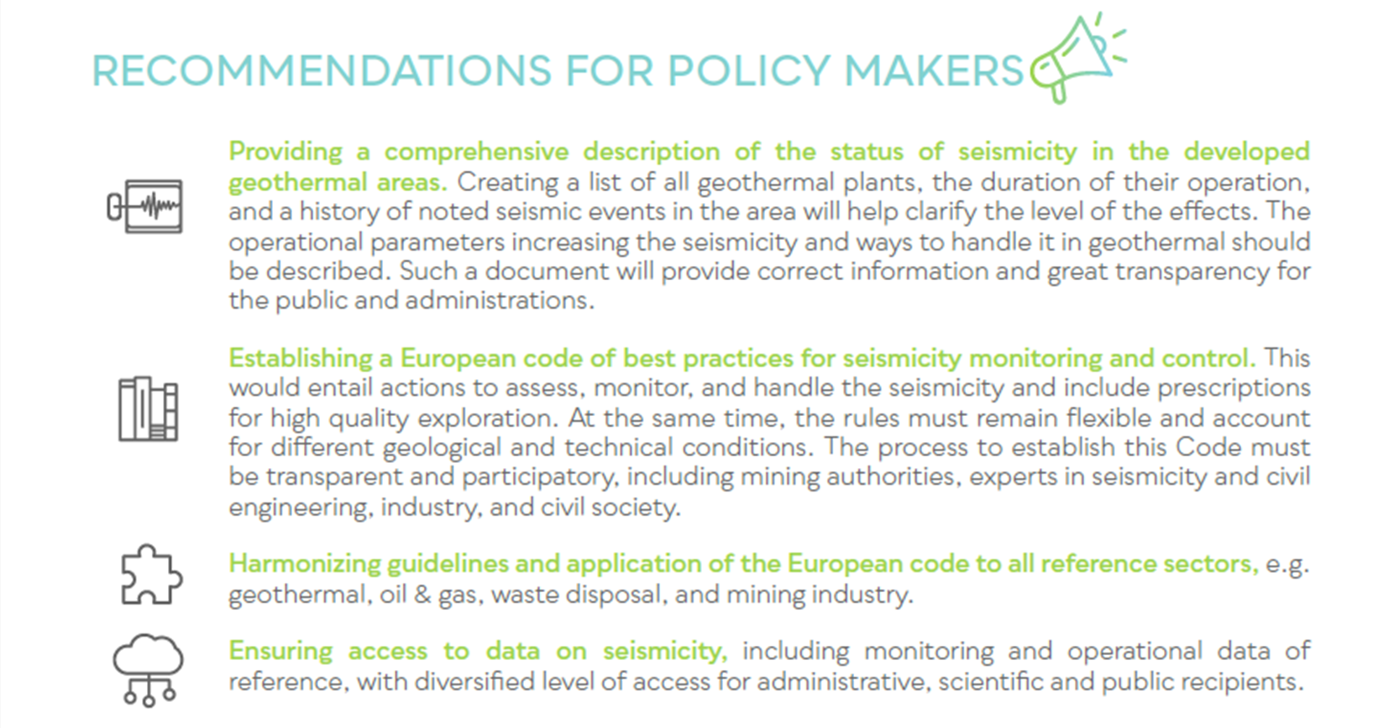

Slide 39
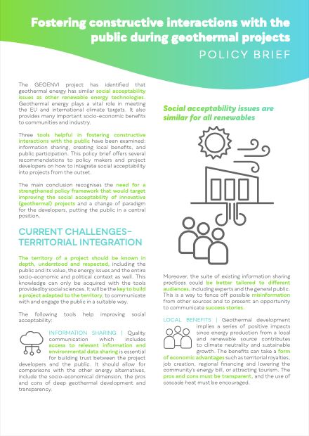
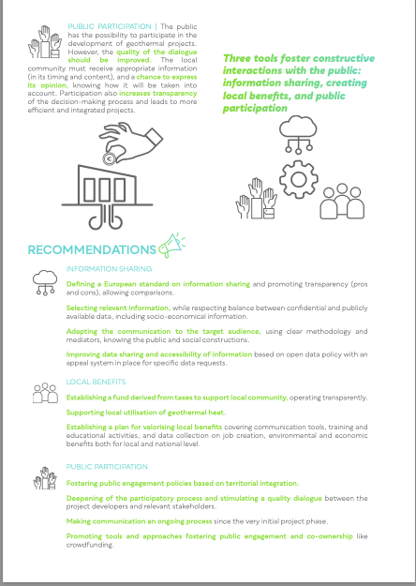


Slide 40
Quality of public participation
European Union’s Horizon 2020 G.A. 818242
https://www.geoenvi.eu
Results of the public inquiry may not reflect the public position on a project, as the public can remain silent or choose other ways to express opposition, like litigation.
GEOENVI analysis:
There is often low participation in the population
Difficulty to communicate
Difficulty in taking into account the opinions expressed, sometimes “unconstructive”, on a very engineered object (the impression that there are not a lot of practical options to be discussed)
The public inquiries can reflect a feeble consent or be a platform for protests; it is a common democratic issue. Each project has its specificities (unique socio-technical object)

Slide 41
Recommendations for public participation
European Union’s Horizon 2020 G.A. 818242
https://www.geoenvi.eu
https://www.geoenvi.eu/wp-content/uploads/2021/05/Public-engagement-policy-brief-Final.pdf
Deepen the process: aiming at a good quality dialogue
Fostering the public participation (e.g. Geothermal project development incorporated in the primary/secondary school education programme (Hungary, Flanders), site visits), and go further than the legal minimum requirements (with stakeholder committees, pre-project consultation ….), with a transparent and harmonized protocol.
Improving communication both ways and mutual knowledge
Seeking Protocols (e.g. Geothermal Sustainability Assessment Protocol GSAP) to take into account the environmental, social, technical, and financial issues.
Accepting the project to be questioned and taking the opinions into account
Expand the perimeter
Geographic perimeter: reach the population actually concerned by the project (neighbourhood cities and intercommunal level),
Governance perimeter: importance of the involvement of the local authorities, if general public is difficult to reach, some associations or other stakeholders can be involved
Adapt the timing
Importance of early communication on the project
Ongoing process
Adapt the process to the territory
Seek project-based dynamic communication, information, and participation processes, combining formal and informal means of communication with the local population

Slide 42
Recommendations
European Union’s Horizon 2020 G.A. 818242
https://www.geoenvi.eu
https://www.geoenvi.eu/wp-content/uploads/2021/05/Public-engagement-policy-brief-Final.pdf
For improving data sharing
For improving, highlighting and communicating local benefits
Define a European standard on information sharing, defining the minimum amount and type of data and encouraging to go further
Choose and collect the relevant information to be able to compare geothermal utilisation to the utilisation of other energy media, comparable data should be collected and FAIR (Findable, Accessible, Interoperable and Reusable) principles in data management should be adopted.
Adapt the communication to the target: mediation, clear terminology and best dissemination support according to the target group
Improve data accessibility and awareness of accessible information
Share reliable information and data
Establish a Fund derived from taxes/royalties to support the local communities and regions
Support the local utilization of geothermal heat to create a circular and co-designed use of local geothermal resources
Establish a plan for valorising local benefits: information collection (jobs, benefits…), information, training

Slide 43
ASANTE
for the attention
adele.manzella@igg.cnr.it

