Slide 1


DIAGNOSTIC SERVICES
and
PREDICTIVE DIAGNOSTIC SYSTEMS

Slide 2
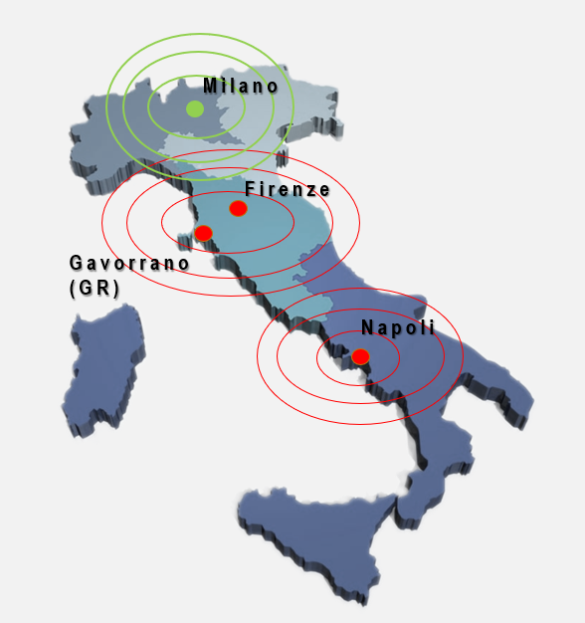





OPUS AUTOMAZIONE Spa
INDUSTRIAL AUTOMATION
TESTING
TURBOMACHINERY
and I-IoT
ENVIRONMENT
Design & Software Development
Integrated and complete service for industrial and process automation
Test Bench for industry and defense
New Test Benches realization Revamping and Upgrading
Remote and Predictive Diagnostic services
Field Testing and Industrial-IoT
Design - Construction
Maintenance - Software
Continuous emission monitoring systems

Slide 3
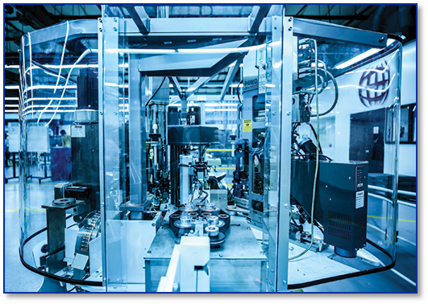
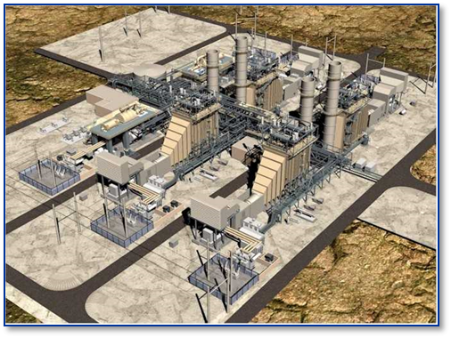
Diagnostic Services
  The plant reliability and production can be improved and optimized through plant asset monitoring.
  For an accurate management of an industrial plant, an improving of its reliability and a reduction of the unplanned shut-down, it is very important to be aware about the real operating conditions and status of the plant assets. In particular the following features shall be kept under monitoring:
  Machine Performances
  Plant/machine KPI (Key Performance indicators)
  Critical operating parameters and main plant/machine issues
  Moreover, to reduce unplanned shut-down of the plant, prevent possible machine failures and anomalies is fundamental to implement a dedicated predictive diagnostic service.

Slide 4
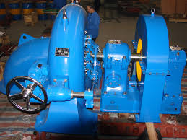
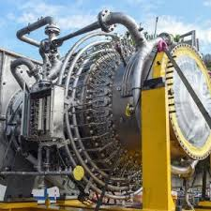
Diagnostic Services
This diagnostic activities can be applied to several industrial fields as Oil&Gas, geothermal, paper industry, plastic packaging production plants, chemical industry, etc. In particular:
Electricity production and cogeneration plants (turbogenerator)
Natural gas transportation and re-injection plants (turbocompressor)
Paper mills and plastic film production plants
Industrial fans and blowers
Mainly the Predictive Diagnostic is applied to rotating devices, to prevent unexpected shutdown and machine failure, as follows:
Electric motors
Pumps / Fans
Gas / Steam turbines
Axial / Centrifugal compressors
Gearbox
Auxiliary systems

Slide 5
Diagnostic Services
  WHY IMPLEMENT A DIAGNOSTIC SERVICE ON AN INDUSTRIAL PLANT?

Slide 6
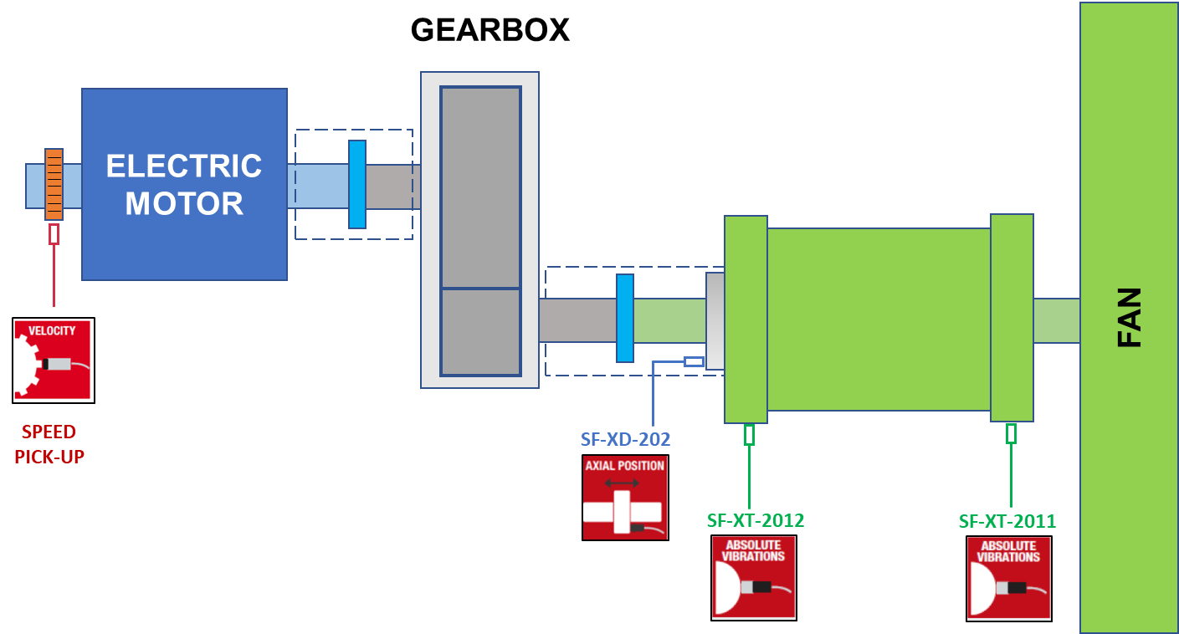
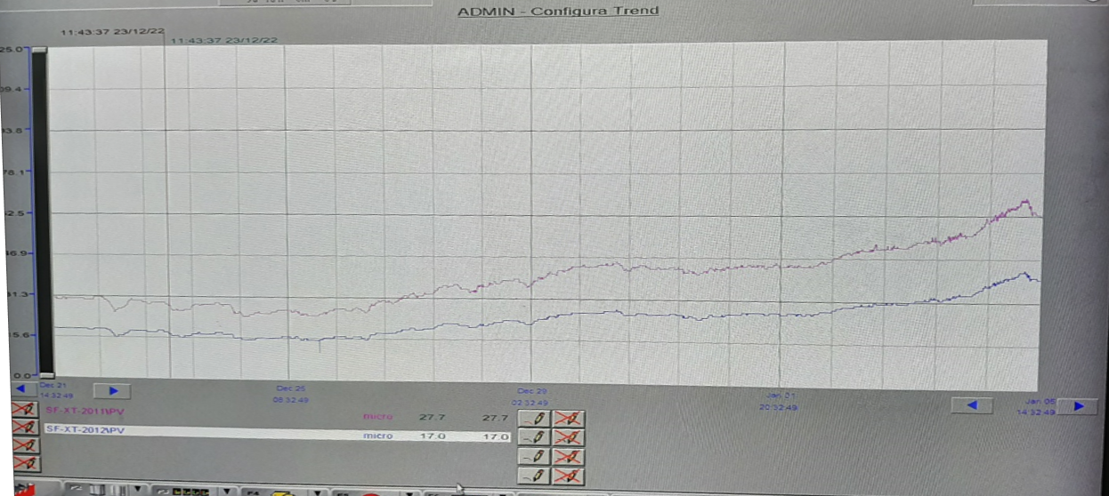
CASE HISTORY 1
A vibration level increasing was observed on both seismic probes, installed on the bearings of a blower, operating in a chemical factory for the sulfuric acid production.
The vibration start increasing but nobody on the plant was aware about it for about 10 days. Once the vibration level reached the alarm value (60 µm pk-pk), set in the machine control panel, the plant operators reacted to this issue, that was mitigated modifying the lube oil temperature.
Fortunately unexpected plant shutdown, that would have led to a loss of production damage, was avoided.
The implementation of a Predictive Diagnostic system would have allowed to promptly response to this issue mitigating immediately the plant shutdown risks.

Slide 7
Diagnostic Services
PREDICTIVE DIAGNOSTIC systems allow recognizing and acting on the critical plant components/machines, for the maintenance standpoint, identify in advance machine malfunctions, define the residual time before a machine failure, that allows managing maintenance activities.
Summarizing the final scopes of PREDICTIVE DIAGNOSTIC systems (condition monitoring) are as follows:
  Minimize machine/plant shutdown and enhance process machine/plant reliability
  Achieve a correct overview of the machine/plant status, relevant performances and KPI
  3. Improve scheduled maintenance activities by decreasing the relevant costs
  Improve warehouse supplying management
An assessment of the machine operating status can be performed by using and monitoring the readings from the defined sensors and transmitters (e.g. vibrations, temperatures, absorbed current, etc.), furnished with the machine, and/or with periodic assessment with dedicated tools.

Slide 8
Diagnostic Services
The level of the diagnostic system to be implemented for each asset presents on the plant depends on the impact of the same asset for what concerns the whole plant throughput, yield and reliability.
HIGH
High level diagnostic service implementation
Reliability optimization
Asset priority level definition = ƒ (impact)
MEDIUM
Periodic check
LOW
Assign priorities to maintenance activities
Postpone or avoid scheduled maintenance interventions
Effort and resources spent on the assets that show potential issues

Slide 9
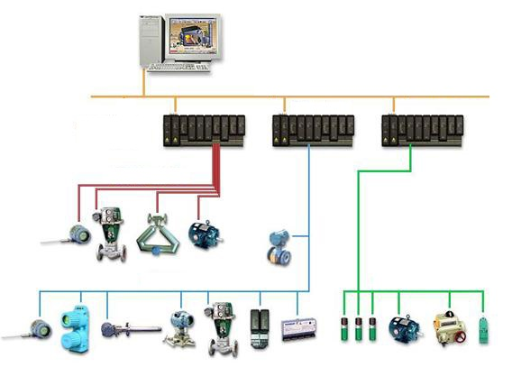
Diagnostic Services – Continuous monitoring
The readings from the sensors and instruments installed on the machines (pressure transmitters, RTDs, thermocouples, flow devices, LVDT, vibration probes, etc) are sent and collected in the plant control panels, PLC, DCS and CN.
Mainly defined alarm and shutdown thresholds are applied on these instrument signals, in the plant control devices, to protect the machines against possible faults.
A high-level elaboration of these data (“Big Data Analysis”) leads to a plant/machine/asset operation and maintenance improvement, as listed in the previous slides.

Slide 10
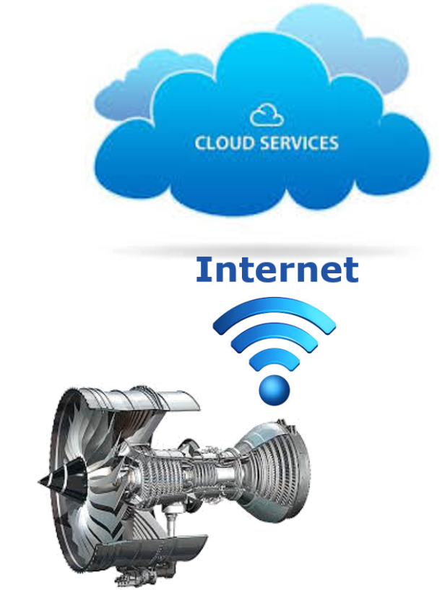
STEPS TO BE FOLLOWED TO IMPLEMENT A DIAGNOSTIC SERVICE:
IT SOLUTION DEFINITION FOR DATA ACQUISITION AND TRANSFER
ACQUIRED DATA MANAGEMENT AND ANALYSIS: definition and implementation of the data acquisition modalities and the relevant diagnostic algorithms (rules) to be applied for the analysis. Performances and KPI definition and calculation.
DATA ANALYSIS RESULT PRESENTATION: define the modalities and dashboard to show performances and plant KPI, alarms and diagnostic rule results.
Transform the plant assets into I-IoT devices

Slide 11
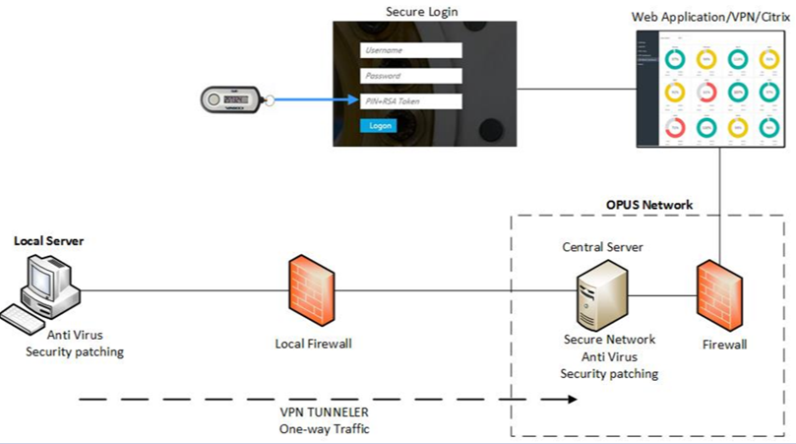
IT SOLUTION DEFINITION
BASED ON THE PLANT ARCHITECTURE AND CUSTOMER CYBERSECURITY REQUIREMENTS, THE DEDICATED DIAGNOSTIC SYSTEMS GENERALLY COMPOSED AS FOLLOWS:
Industrial Server Windows Based installation on the plant.
Software for plant signal acquisition, to be installed on the Industrial Server, using system like IGS, CIMPLICITY, PI OSI SOFT.
Data acquisition from the machine control panel through the defined protocol (e.g. OPC, OPC-UA, MODBUS, PROFIBUS, EGD).
Data transfer outside the Customer's corporate network (possible transfer modes: SSL via ICP 443 port, Tunnel, dedicated VPN).
Database for data storaging on the central server/cloud.

Slide 12
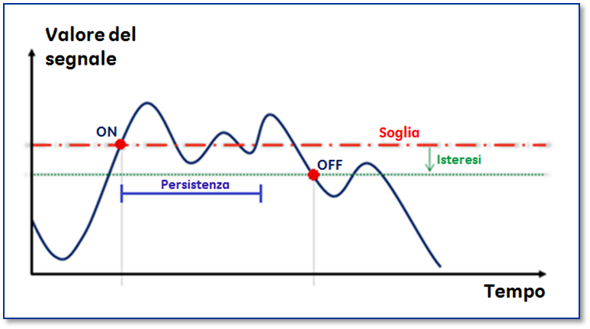
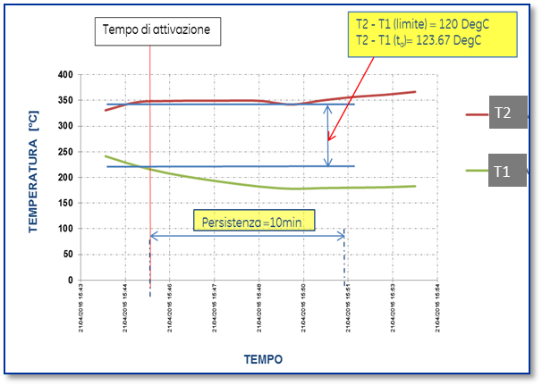
DATA ACQUISITION MANAGEMENT AND ANALYSIS
Signal Value
SYSTEM CONFIGURATION STEPS:
Plant signals mapping in order to detect the significant readings to an appropriate diagnostic and control of the plant equipment.
Signal acquisition frequency definition:
- FIXED (e.g. 1 data per minute)
- DEPENDING ON THE EVENTS
Algorithms (rules) implementation for acquired data quality and reliability evaluation in order to detect, in particular, instrumental faults.
Increasing criticality threshold definition, for each measurement, with alerts activated when specific reference values have been exceeded, both as a function of the normal operation values and the alarm/block values set by the manufacturer. For each threshold value a persistence and hysteresis time shall be set.
Threshold
Persistence
Hysteresis
Time
Activation Time
TEMPERATURE
Persistance=10min
TIME

Slide 13
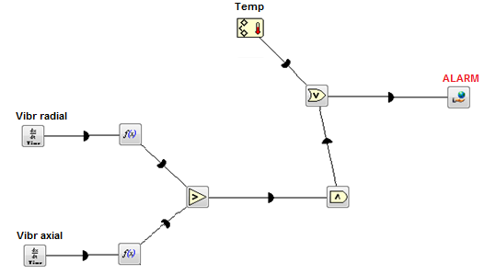
DATA ACQUISITION MANAGEMENT AND ANALYSIS
SYSTEM CONFIGURATION STEPS:
Specific rules and algorithms definition which combine, through specific functions, the signals coming from different machine instruments usually related to the same machine component. These rules triggering and the analysis of the relevant event can lead to the definition of possible maintenance actions or warnings/suggestions for future actions.

Slide 14
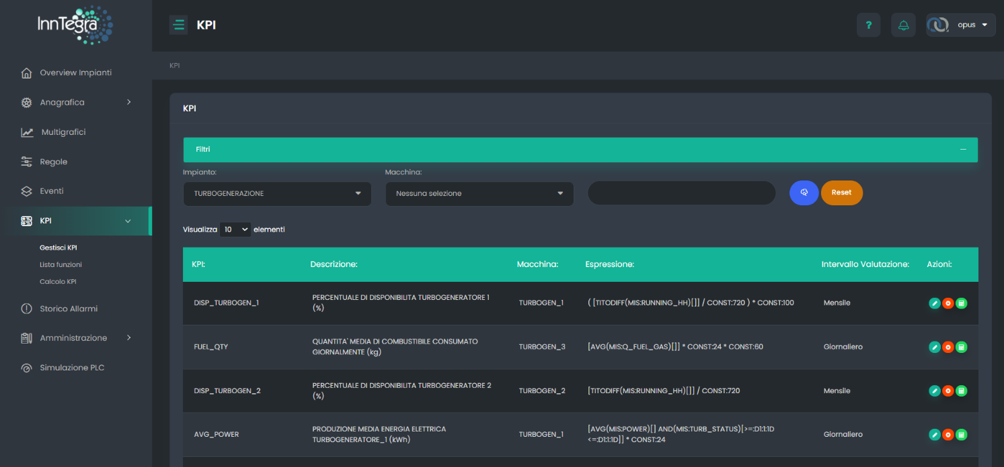
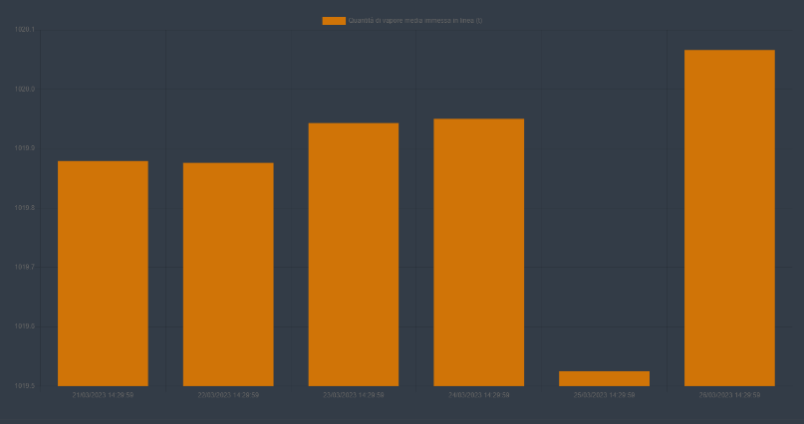
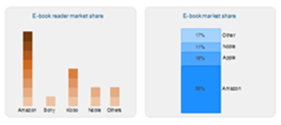
DATA ACQUISITION MANAGEMENT AND ANALYSIS
SYSTEM CONFIGURATION STEPS:
KPI definition (Key Performance Indicators) with the relevant target values:
Equipment running hours
Average time between 2 unplanned stops
Plant saturation
Productivity of machines
Machine performance calculation
Performances and KPI can be shown online directly on the monitoring system, on dedicated dashboards, to have an idea of the production trends.

Slide 15
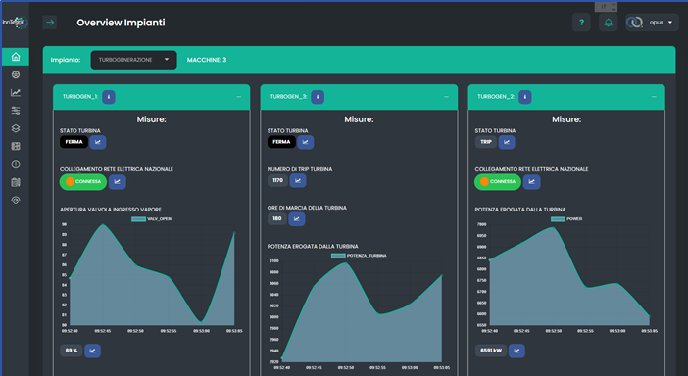
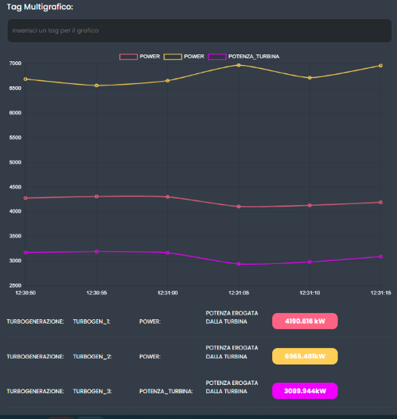



Diagnostic Software
  PREDICTIVE MAINTENANCE
  PERFORMANCE MONITORING
  RESOURCE OPTIMIZATION
  On the market there are dedicated software to implement diagnostic services for the industrial plants. The main features of these software are as follows:
  Acquire data from the field relating to a production plant.
  Monitor the real operating conditions and performance of the machine over time.
  Create rules and algorithms for analyzing the acquired data, in order to generate alarms in the event of anomalous or potentially dangerous situations for the system.
  Create and manage customized reports on the progress of the plant.
  Performance and KPI definition
  Interface with the world of management and maintenance software.
  Once correctly configurated, these software can also be managed by the plant personnel to achieve a deep overview of the plant status.
  These software can usually send notifications via email or SMS, to selected persons, in case of alert activation on the plant machines.

Slide 16
Remote Diagnostic Services
  This high-level diagnostic service can also be managed by specialized company for both the initial setup of diagnostic services/software and the remote technical assistance to Customer, in particular the service consist of:
  IT SERVICES → Design and implementation of IT solutions for connection and machine data transfer
  → On site installation for configuration and putting in operation of acquisition systems
  → IT assistance for data transfer control acquisition and monitoring (L2 Help Desk)
  PLANT DATA MONITORING & ANALYSIS → Specialist service in real time for analysis and management of process alarms
  DATA MANAGEMENT SERVICES → Configuration and tuning of operating plant parameters with monitoring service
  → Information on KPIs at fixed intervals and machine/plant performance calculation
  → Reporting: periodic reports execution about plants analysis operation and insights
  → Investigations for complex cases

Slide 17
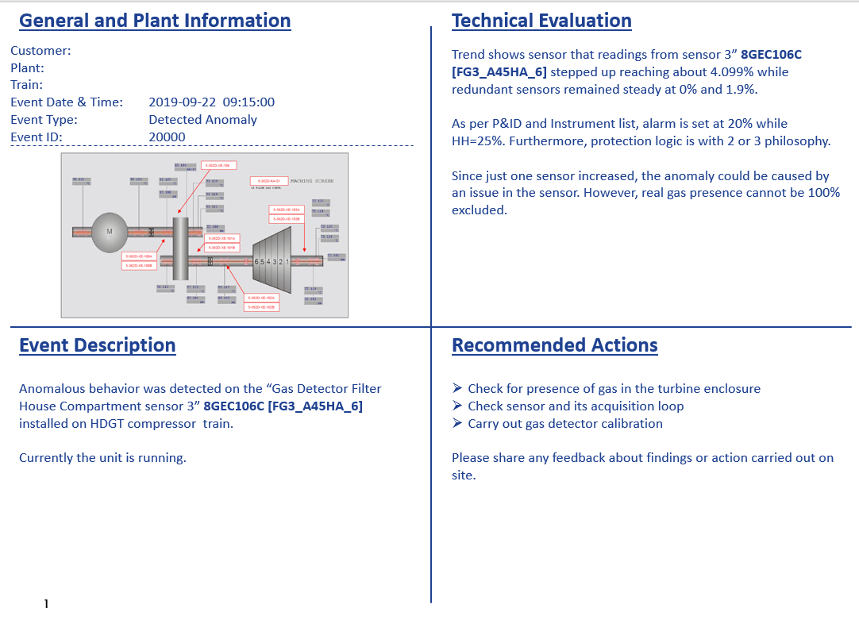
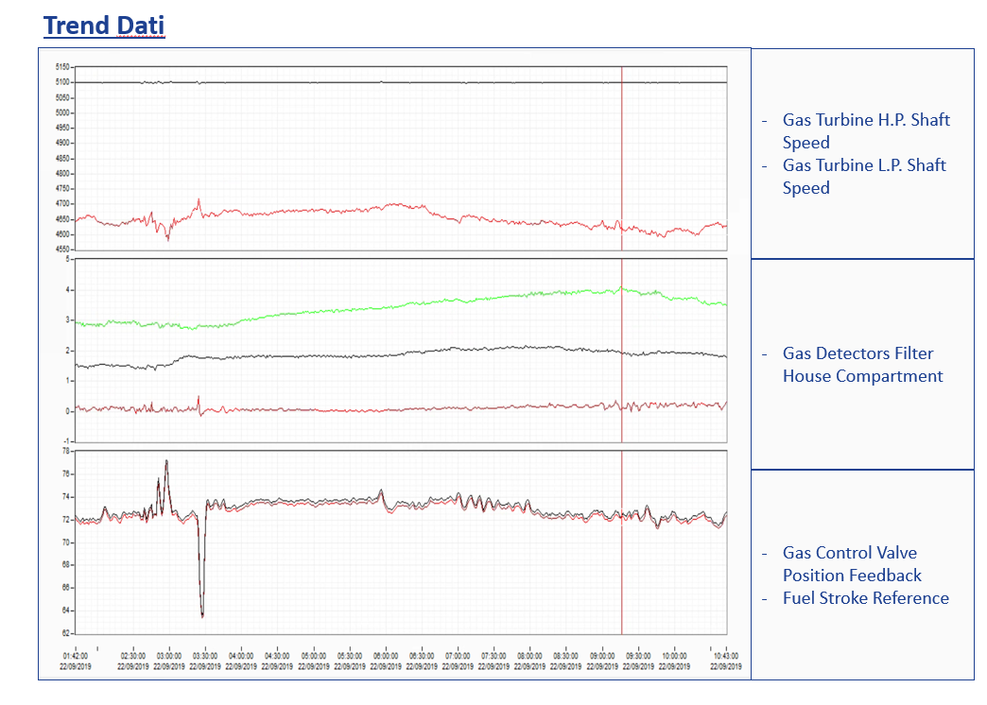
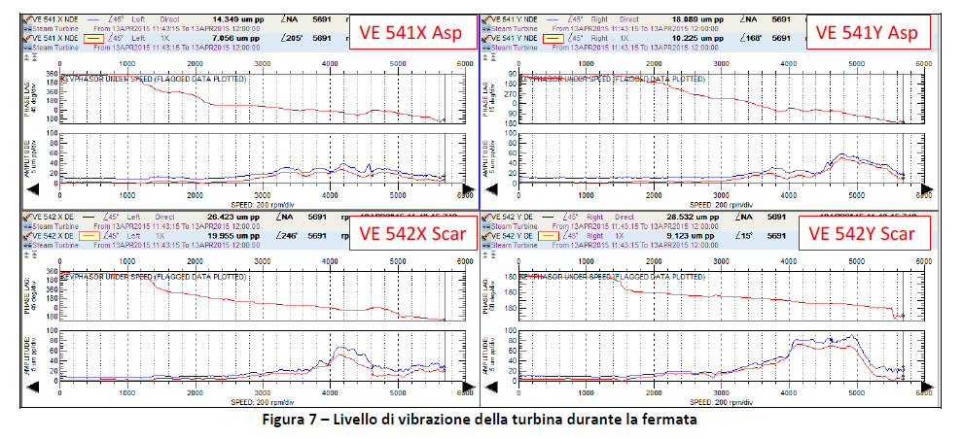
DATA ANALYSIS RESULT PRESENTATION
Notifications sending to the Customer after alarm activation (automatically or after analysis by specialized personnel) with suggestions on identifying the causes of the anomaly.
Information on KPIs at fixed intervals
Report issue:
Reference to the notifications sent in the
specified period
Graphs showing the trend of the main
controlled signals and parameters in the
reference period
Performance and KPI trends
Comments on the status of the machines,
indications on the probability of the
machine component faults and on
maintenance management

Slide 18
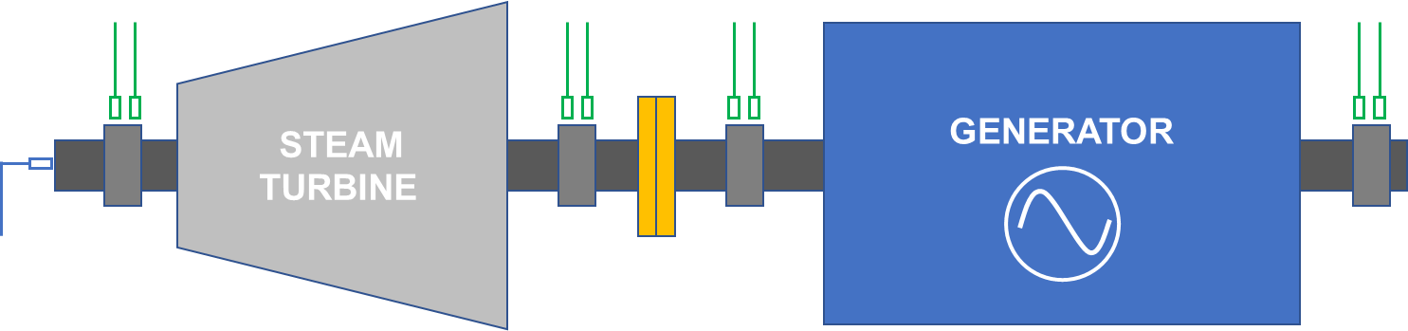
EXAMPLE OF TURBO-GENERATOR READINGS TO BE MONIOTORED
  Further plant readings, related to other plant systems/assets (e.g. heat exchangers, pumps, etc.) can be set under monitoring.

Slide 19
Diagnostic Services
Continuous check and monitoring of the machine parameters
Periodic machine critical parameter assessment
Machine KPI assessment
Machine performance calculation and optimization
Deep machine functioning analysis after maintenance activities

Slide 20
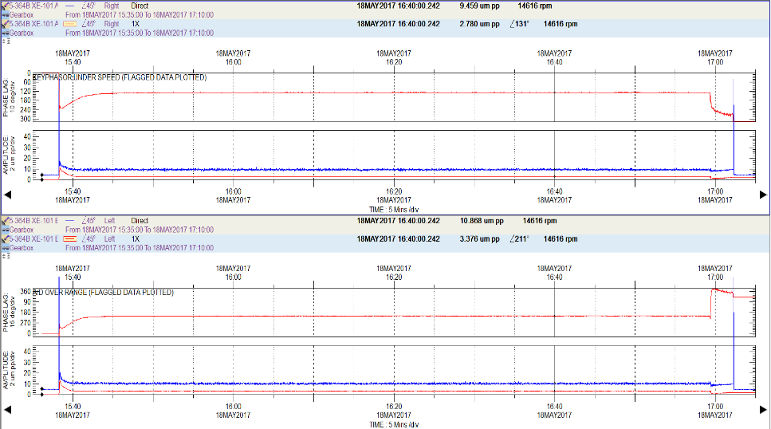
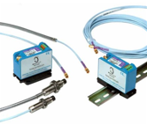

CASE HISTORY 2
  Vibration analysis campaign on 3 natural gas compression trains (each consisting of an electric motor, a gearbox and a centrifugal compressor) during the start-up timeframe of a plant of the Oil&Gas sector, after the annual maintenance shutdown.
  High levels of vibration were recorded on two centrifugal compressors and two gearboxes. These vibration values ​​were close to the critical alarm thresholds defined by the manufacturer to operate the compression trains in safe conditions.
  In order to solve these rotor dynamic problems, and avoid unexpected machine shutdown during normal production, a rotodynamic balancing (trim balance) were performed on these machines, in collaboration with the customer's technicians.
  At the end of the activities, the vibration levels of the compression trains were widely below the alarm levels. This made it possible to put all three units into normal production operating in safe conditions.

Slide 21


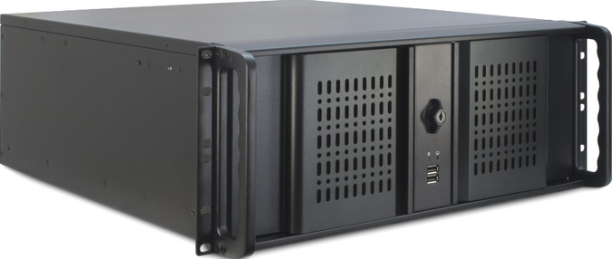
Remote service overview
PLANT DATA ACQUISITION SYSTEM (FROM DCS, PLANT PLC AND/OR MACHINE CONTROL SYSTEM)
ON SITE DATA ACQUISITION
DATA TRANSMISSION
DATA STORAGE SYSTEM
EXTERNAL SERVER - CLOUD

Slide 22
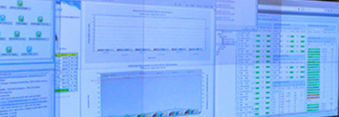
Remote service overview
DATA STORAGE SYSTEM
EXTERNAL SERVER - CLOUD
DATA MANAGEMENT SERVICES
  Information on KPIs at fixed intervals
  Machine / Plant performance calculation
  Period report regarding the machine/plant status, performances and maintenance management
  Investigations for complex cases
IT SERVICES
On Site Data Acquisition installation
IT solution definition and application for data transmission
IT system maintenance and acquisition data quality monitoring (L2 Help Desk)
The target is:
Detecting hidden malfunctions.
Prevent alarms events in early time.
Reporting in short time to the customers
Specialized technicians, using adaptive tools, supervise remotely the processes assuring a cover of 365 day per years.
On-line machine data and anomalies analysis
Notifications sending to the Customers after diagnostic rule activation.
PLANT DATA MONITORING & ANALYSIS

Slide 23
Performance Assessment
The machine data (pressures, temperatures, flow rates,...) are the basis for the machine performance calculation and evaluation.
Step 1
Machine performance calculation
Step 2
Comparison to the expected / design performances
Parameters trend analysis
Step 3
Production / Process parameter enhancement
Machine degradation reasons detection

Slide 24
Performance Assessment
Step 1
Machine performance calculation
DELIVERED / ABSORBED POWER
EFFICIENCY/ HEAT RATE
STEAM / FUEL CONSUMPTION
EMISSION

Slide 25
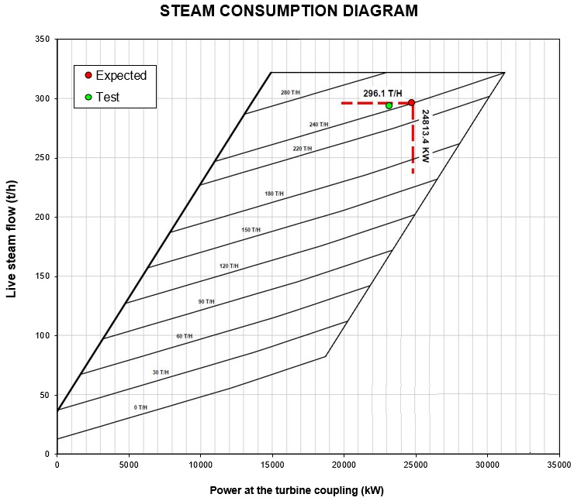
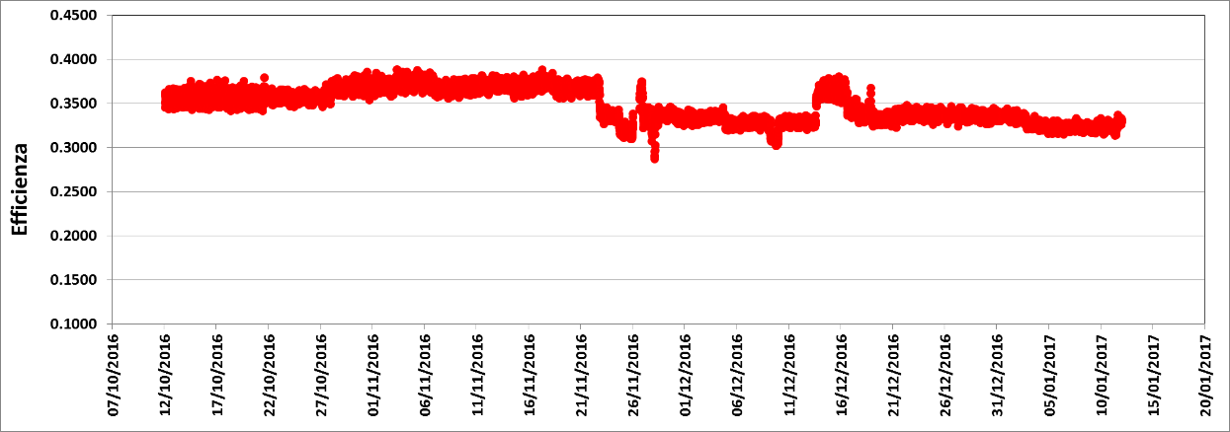
Performance Assessment
Step 2
Comparison to the expected / design performances
Parameters trend analysis

Slide 26
Performance Assessment
Step 3
Evaluation of plant parameter modification in order to increase machine efficiency and productivity
Production / Process parameter enhancement
Machine degradation reasons detection
Detect critical assets and machine parameter degradation sources.
Assign priorities to maintenance activities

Slide 27
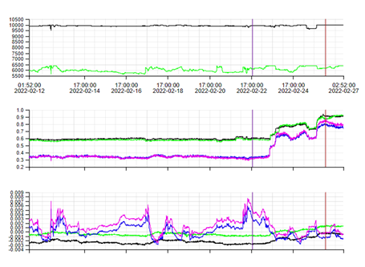
CASE HISTORY 3
A step increase was observed on radial vibrations NDE-side of HP compressor and DE-side of the LP compressor at the same time.
In particular: HP (NDE)+0.5 mil ; LP (DE)+0.3 mil.
Current radial vibrations values are still far from related alarm and trip limits (respectively, H=3.54 mil; HH=4.33 mil).
The same behavior was noted in a similar unit that led to the failure of the coupling between compressors ---> unit shutdown for coupling inspection
Turbine Speeds
Compressor HP DE SIDE
vibration level [mil]
Compressor LP NDE SIDE
vibration level [mil]
Disk pack showed deformation and severe damages
Compressor axial displacements

Slide 28
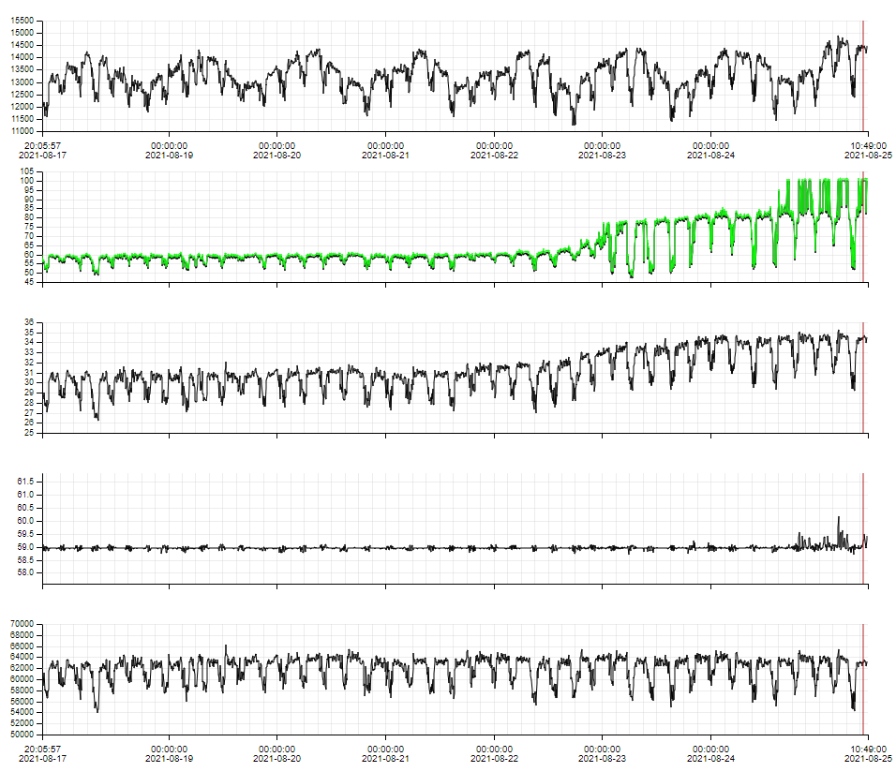
CASE HISTORY 4
The steam pressure after wheel started to increase over time.
The steam inlet control valve started showing an increasing trend, sometimes reaching the full opening position at 100%.
During the above-mentioned observations, no significant change was noticed in the steam inlet pressure, nor in the steam inlet flow.
The increasing of the steam pressure after wheel, without significant variation of the power output, may indicate some phenomena related to a potential fouling along the turbine.
The fouling could lead to lower turbine performance (lower power output, higher steam consumption rate) and to a potential negative impact in the mechanical characteristics (corrosion, aging problem, internals).
A shutdown was arranged for this unit to perform a boroscopic inspection to check internal status of the turbine (maintenance management).
The inspection confirms that the fouling is present in the internals (white deposit on the rotor wheel N°4).
A correction of the quality of the steam was necessary to reduce the fouling in the turbine and to avoid any issue.
Active Power
Steam inlet valve opening
Steam pressure after wheel chamber
Steam inlet pressure
Steam inlet flow

Slide 29
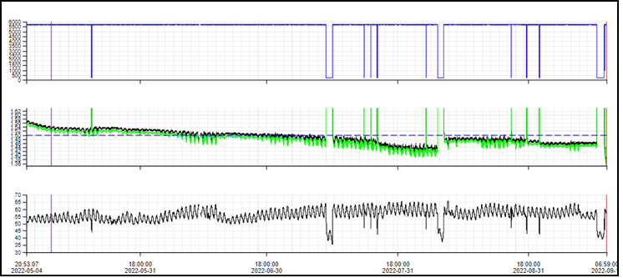
CASE HISTORY 5
Long trend highlighted a monotonic decrease on the mineral oil header pressure reading, minimum value of 1.35 barG (the mineral oil header pressure set is 1.5 BarG, LL = 1.0 BarG).
It is also observed no alarm generation on the lube oil filter DP pressure-switch.
Possible filter clogging.
Indications for the Customer:
Verify the correct Pressure Control Valve set point.
Check the lube oil filter DP and in case switch to the spare one filter.
Mineral oil header pressure

Slide 30
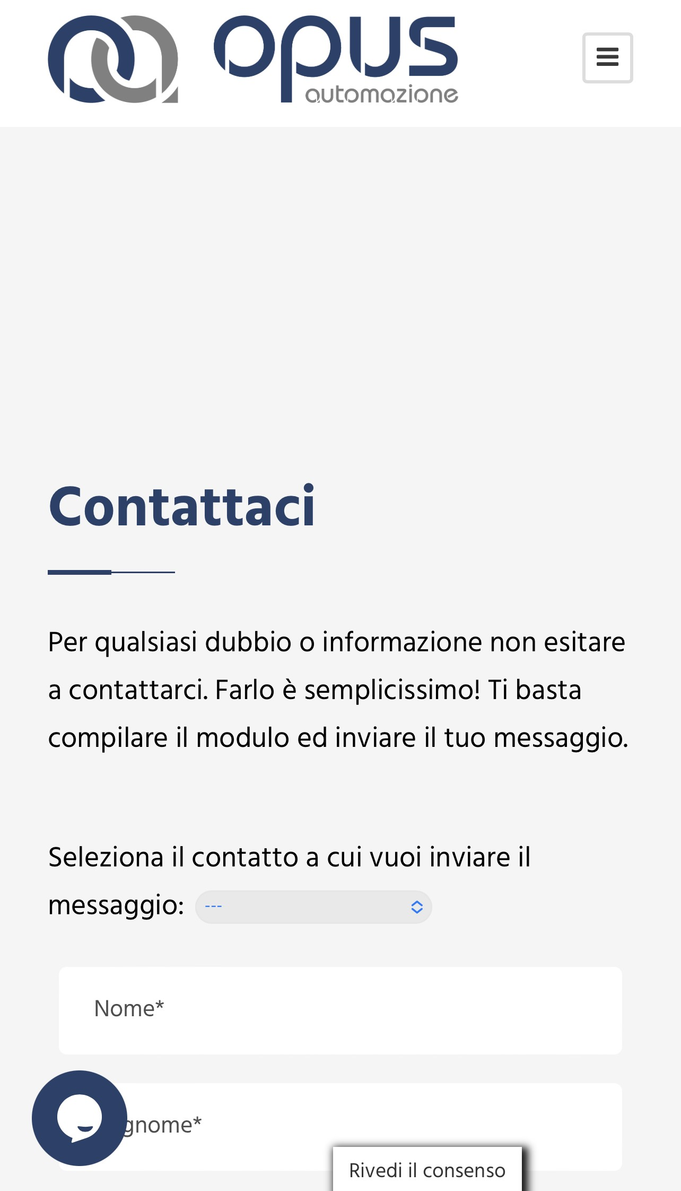
THANKS FOR YOUR ATTENTION
lpastorelli@opus-automazione.it
65%
3
+39 3451047014
69%

