Slide 1
Enel Green Power
WELL DELIVERY PROCESS
Alberto Marcello Fantozzi
Head of Well Management
July 2023

Slide 2
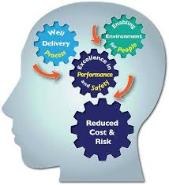
Agenda
Well Delivery Process and Well Operations Management System Definitions
Terminology
Typical Pathway of a Geothermal Drilling Project
Well Delivery Process
Well Operations Management System Hints

Slide 3
Well Delivery Process
Definitions
Well Delivery Process and Well Management System are proven methods to deliver wells, improve value and performance while reducing cost
Well Delivery Process defines a set of activities along a timeline to plan, execute and close out the drilling and completion of a well or series of wells.
Well Management System defines the policies, procedures and technical standards related to drilling, completions, well testing, well integrity, well intervention, abandonment operations and associated engineering for the whole life cycle of the well construction, maintenance and decommissioning operations.

Slide 4
Well Delivery Process
Terminology
Project Owner: group or unit who defines the project's scope, objectives, and requirements. The project owner works closely with the project manager and team members to ensure project success
Business Development (BD): Unit responsible for implementing strategies and opportunities across the organization
Engineering & Construction (E&C): Unit responsible for the engineering and the execution of approved projects
Preliminary Geothermal Study: includes the evaluation of all the available documentation concerning the area where the geothermal project may develop, such as geology, geochemistry, geophysics, and logistics. This is s preliminary assessment of the project.
Surface Exploration: consists of chemical-physical surface investigations, geo-seismic campaigns and drilling of stratigraphic wells (slim holes): this does not involve significant environmental impacts but could involve major investments.
Deep Exploration: Drilling activity
Project Manager: professional who has the responsibility of the planning, procurement and execution (time & cost) of an approved project
Mining Proposal: is finalized just to provide the WE Unit with all the geological info required to proceed with Drilling Services/Material Provision Technical Specifications (especially for LLI)

Slide 5
Well Delivery Process
Terminology
Geology & Geophysics (G&G): Unit responsible to manage all the Geological and Geophysics aspects of a geothermal drilling project
Well Engineering (WE): Unit responsible to perform Drilling, Well Testing & P&A Programs and to define expenditure budgets and project times
Well Management (WM): Unit responsible to manage on site drilling operations according to approved technical programs and to reach the assigned targets in the safest, economic and technically acceptable manner. During drilling phase, WM Unit acts as a Project Drilling Management Unit.
Geothermal Model: interpretative reconstruction, based on available data, of the geothermal system object of the research. The model is constantly updated with the new data acquired with the new project phases.
Project Developer: professional who manages the operations of a project, during Feasibility Phase, by conducting research and creating plans that best suit the needs of the project.
Geological Program: contain all the G&G operative instructions for field use
Field Development Plan: is the company's proposal for developing a field and managing the associated risks

Slide 6
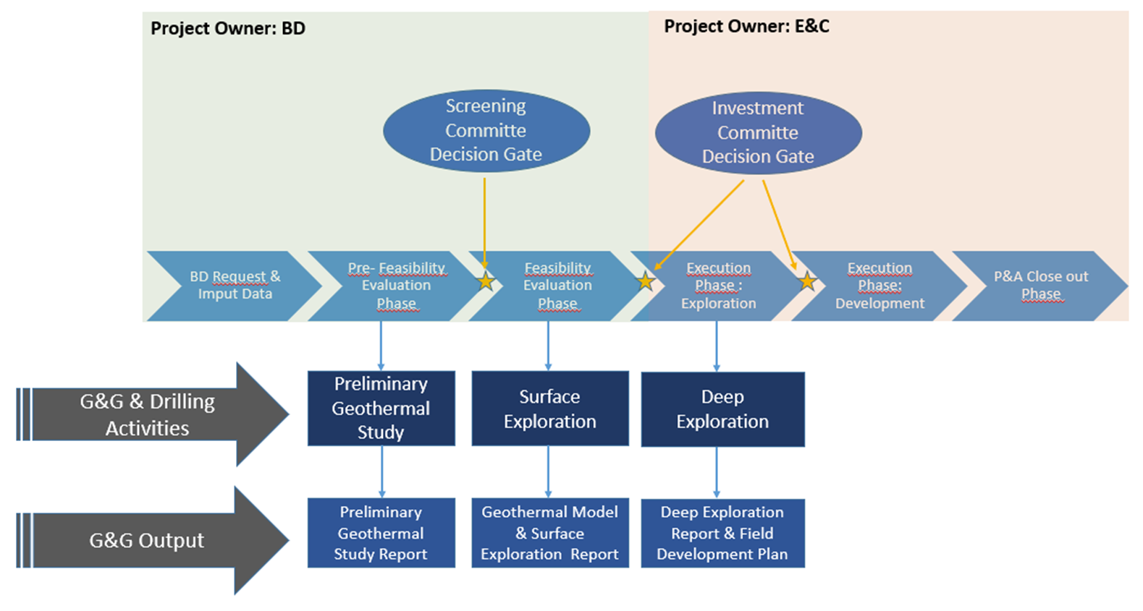
Well Delivery Process
Typical Pathway of a Drilling Geothermal Project
Pathway related to exploration and development wells

Slide 7
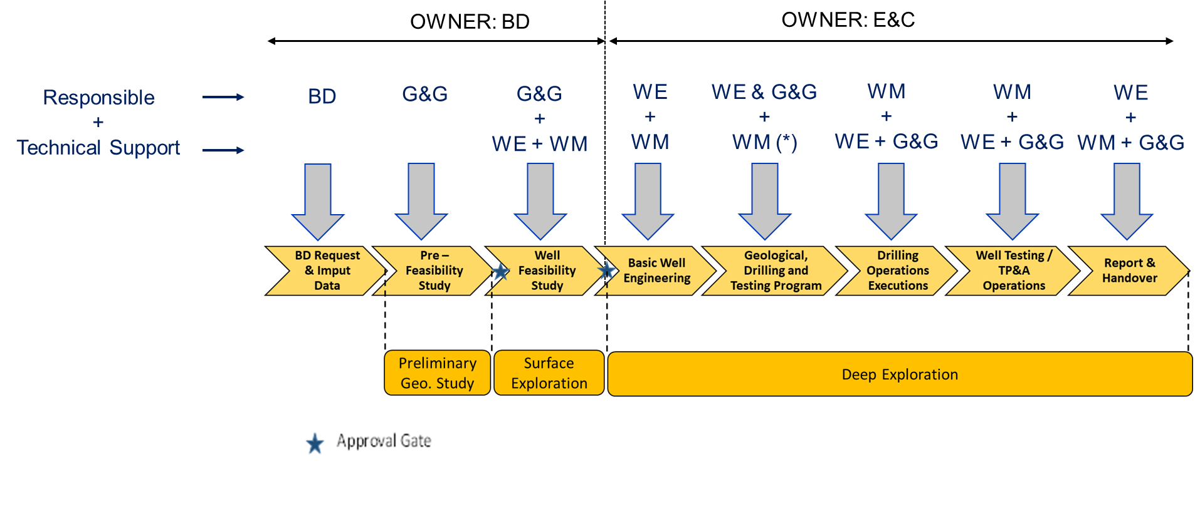
Well Delivery Process
Process Phases - Exploration Well
(*): WM endorses all technical programs

Slide 8
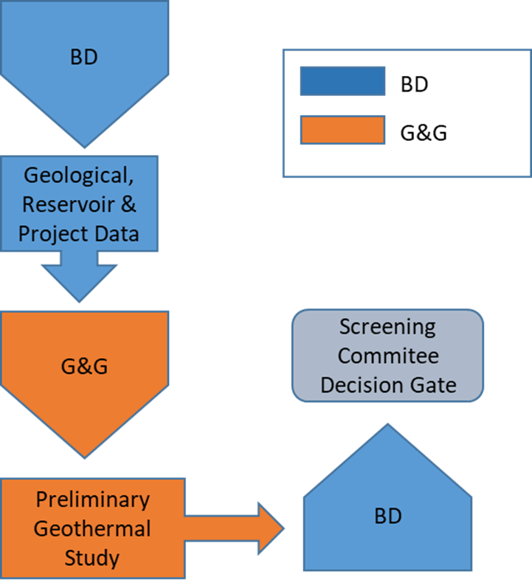
Well Delivery Process
Pre-Feasibility Phase
PHASE RESPONSIBLE: G&G
G&G >> Preliminary Geothermal Study
The Pre-Feasibility Evaluation Phase, managed by G&G, consists mainly in the execution of bibliographic studies to see if the proposed area appears "interesting“.
Scope of this phase is to obtain the Company’s internal approval to proceed with the Feasibility Study

Slide 9
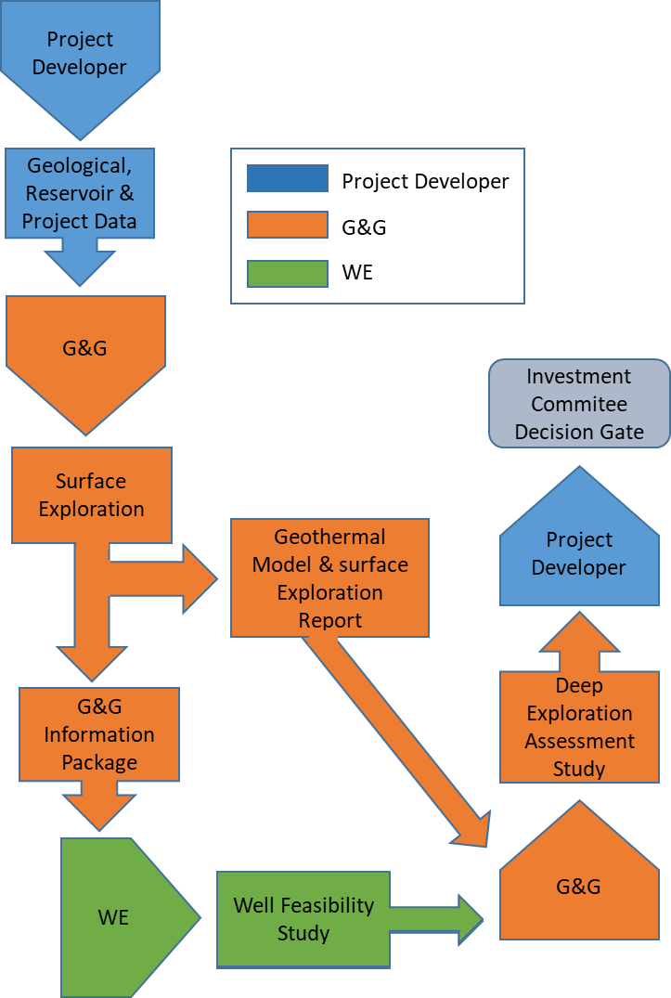
Well Delivery Process
Feasibility Phase
PHASE RESPONSIBLE: G&G
G&G >> Geothermal Model & Deep Exploration Assessment Study
WE >> Well Feasibility Study (Time & Cost)
WM >> Support Well Engineering
The Feasibility Phase is finalized to deliver a preliminary evaluation (in term of time and cost) for the drilling of an exploration well in response to a request from the Project Developer, who should also provide a budget for its execution.
The scope of this phase is to obtain the Company’s internal approval for the execution of the drilling operations (new wells).

Slide 10
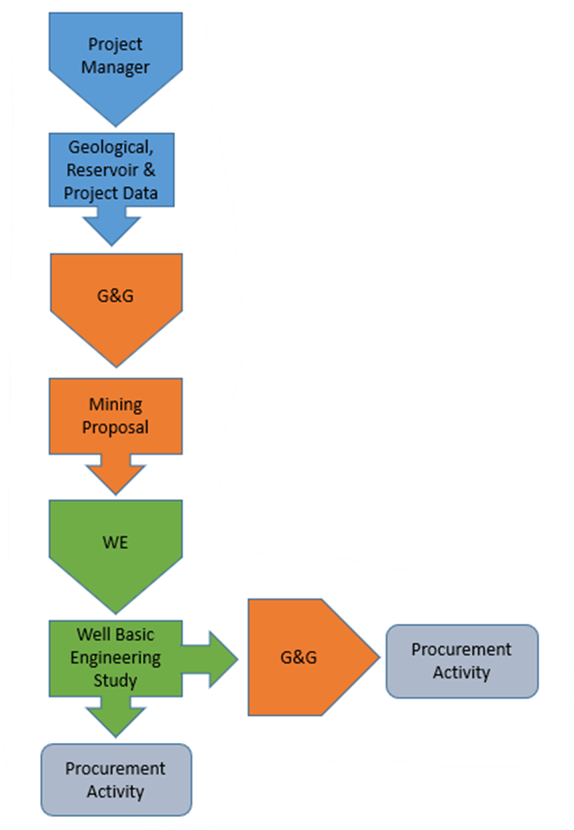
Well Delivery Process
Well Basic Engineering Phase
PHASE RESPONSIBLE: WE
WE >> Well Basic Engineering Study (Time & Cost) To Perform Procurement Activity
G&G >> Mining Proposal
WM >> Support Well Engineering
The “Well Basic Engineering phase” starts after the approval of the drilling project by the Investment Committee.
The “Well Basic Engineering” is finalized to deliver a focused program for the well(s) drilling, testing and P&A operations, primarily in order to precisely identify the requirements in terms of equipment and services and to update the time and cost estimation based on more detailed geological (Mining Proposal), operational and logistic data (if available).

Slide 11
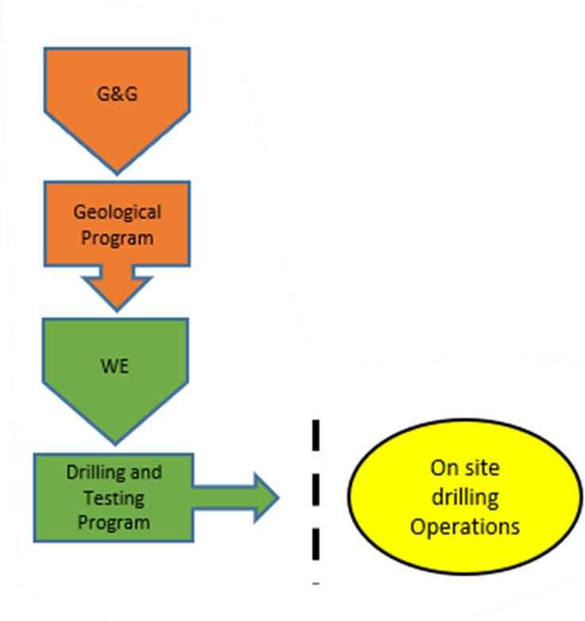
Well Delivery Process
Technical Programs Issue Phase
PHASE RESPONSIBLE: WE
G&G >> Geological Program Issue
WE >> Drilling And Testing Program Issue
WM >> Support Well Engineering
The preparation of the Drilling and Testing Program comes after the Well Basic Engineering study by WE and the Geological program issued by G&G: the engineering, the technical and operational requirements are further analysed in detail and verified respect the hazid and risk assessment. At this stage, the Testing program is just preliminary: the detailed one will be prepared and issued in case of decision to proceed with testing operations.

Slide 12
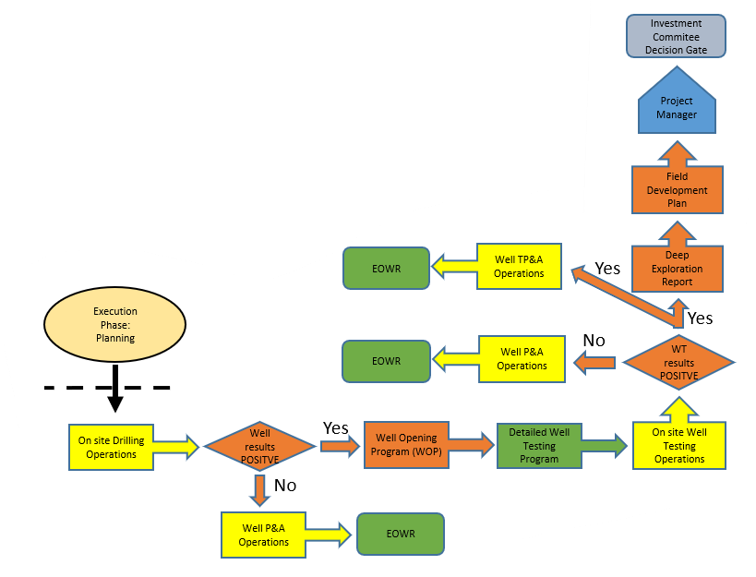
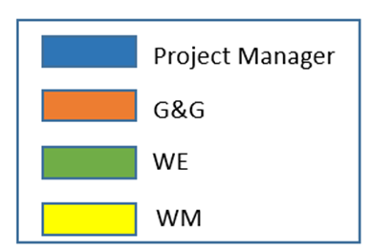
Well Delivery Process
Execution Phase: On Site Operations
PHASE RESPONSIBLE: WM
WM >> In Charge To Manage On Site Operations According To Technical Programs
WE >> Provide Well Engineering Support
G&G >> Provide G&g Support - Deep Exploration Report & Field Development Report Issue
The execution of the well operations consists of the implementation of the Geological, Drilling and Testing Program, reaching the assigned targets in the safest, economically and technically manner.
Well, if positive, is handed-over to the Operations (if suitable for production) or TP&A. The Development Plan is prepared to pass the investment decision gate

Slide 13
Well Delivery Process
Technical Programs Issue Phase
PHASE RESPONSIBLE: WE
WE >> In Charge to Issue the « Eowr»
WM >> Provide Well Management Support
G&G >> In Charge to Issue G&G Report & Provide Geology & Reservoir Support
Following the conclusion of the well operations, Well Engineering shall issue, in due time, the “End of Well Report” (EOWR), inclusive of the testing and P&A operations, if the case.
EOWR is the base for the knowledge management of the Operator’s Well Operations Unit

Slide 14
Well Operations Management System Overview
Drilling Operations Management
Well Operations Management System
EGP Drilling is endowed with a «Well Operations Management System»: scope of a Management System is to define how an Organization manages its activities as to ensure that they are performed in accordance with defined and measurable standards.
For the Well Operations, this is achieved through the application of policies, procedures and best practices in order to ensure the maximum level of safety while optimizing the operational performances.
The EGP Well Operations Management System is aimed to ensure that all activities are performed in full compliance with the EGP standards and policies, the applicable Laws and Regulations, especially regarding the HSE issues, in order to safeguard the reputation of EGP
Throughout the whole cycle of the project execution (Plan-Do-Review-Assess) the Drilling Main Office shall be the reference for the Local Drilling organization (if any) as far as the application of the Management System and the performance of the well operation are concerned.

Slide 15
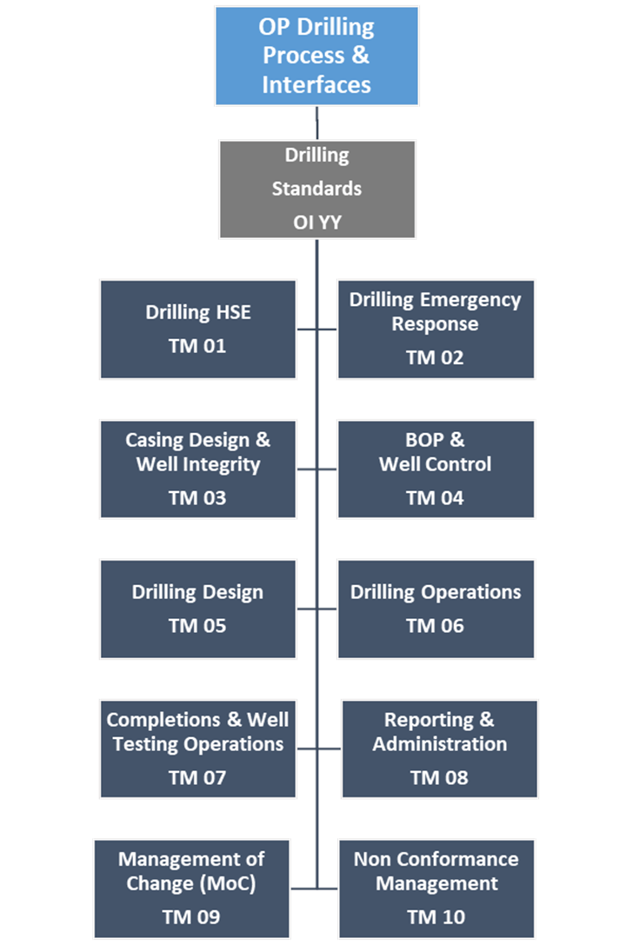
Well Operations Management System Overview
Drilling Operations Management
Drilling operations must be performed in accordance with approved and clear rules and best practices. EGP has, in progress, a «Drilling Operations Management System» as follows:
N. 2 Operative Procedures
N. 10 Technical Manuals
In progress

Slide 16
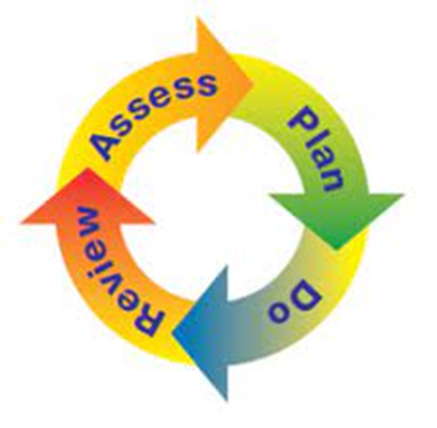
Well Operations Management System Overview
Plan>Do>Review>Assess
The PDRA Cycle (Plan>Do>Review>Assess cycle) shall drive all stages of a project execution. For each phase we have the following key point:
Plan
To identify the project requirements in order to outline the key requirements, the EGP’s internal concerned interfaces, the external contributors.
To arrange in advance a Project Execution Plan (PEP); this is helpful in defining in detail the scope of work, the roles and responsibilities of all parties involved, making it known to everybody involved.
To perform hazid (hazard identification) and risk analyses not only for the well operations but also considering factors such as logistics, permitting, Contractors & Suppliers QA/QC issues, etc. also seeking the involvement of the HSE Dep’t.
To elaborate the AFE for the well operations and to obtain approval by the management.
To ensure that an effective and specific Emergency Response Plan is prepared; to ensure that Bridging Documents are prepared and approved before the beginning of the well operations.
To ensure that detailed, written operational programs, including outcomes from the risk assessment and considering possible contingencies are prepared, discussed and approved before the start of the operations.
To arrange the pre-spud meeting in due advance prior to the beginning of the operations.

Slide 17
Well Operations Management System Overview
Plan>Do>Review>Assess
Do
To ensure, in due time, that personnel, materials, equipment, services, programs, approvals and authorizations are available and ready to start with the operations.
To execute the operations in accordance to approved written programs and procedures; should contingent event dictate for program change, the Management of Change (MoC) procedures will apply.
To arrange and lead safety meetings and, if required, perform technical and HSE audits.
To ensure constant contacts between the Drilling Operations office and the rig, through a reliable communication system.
To perform exercises to verify effective response in case of emergencies.
To provide for the reporting of operations and for the systematic collection of data and information.
To ensure constant «performance monitoring» (time & cost), actual vs. planned and vs. the established KPI’s.
To collect the lessons learned to prevent the re-occurrence of problem and NPT’s
To monitor expenditures vs. the approved AFE and notify the management in due advance of any extra expenditures.

Slide 18
Well Operations Management System Overview
Plan>Do>Review>Assess
Review
To ensure that information from the operational activities were correctly acquired and verified for accuracy and completeness.
To analyze in detail the problems occurred and report on same also including the solutions implemented, their effectiveness and suggestions in case or re-occurence.
To prepare the «End of Activity» reports as per the approved standards.
To reconciliate the Company’s materials & equipment consumption, providing an accurate list of materials remaining at the end of the well operations.
To reconciliate the cost expenditures, perform analyses and explain reasons for differences in respect of the approved AFE.
Assess
To carry out “lessons learned” sessions with the scope of assessing weak points and promote improvements based on results from the operational performances.
To evaluate the performance of Contractors and Suppliers.

Slide 19
Well Delivery Process
Grazie

